Slide 1
More Is Not Always Better: Accounting Reporting Complexity and Stock Price Efficiency
Presenter: Robin K. Chou¹
Ya-Kai Chang ²
Min-Hsi Chung ¹
¹National Chengchi University
²Chung Yuan Christian University

Slide 2
Paralysis is a consequence of having too many choices. And I think it makes the world look like this. You really want to get the decision right, if it’s for all eternity, right? You don’t want to pick the wrong mutual fund, or even the wrong salad dressing.
Barry Schwartz (2007)

Slide 4
Motivation
In discussions among regulators about whether greater information disclosures benefit efficient pricing in the capital markets, there appears to be a general idea that:
"Disclosure—providing the public with the information necessary to make informed investment decisions—is fundamental to furthering each aspect of our mission…." (SEC, 2020).
"Increasing transparency makes markets more efficient and economies more stable and resilient" (Ilhan et al., 2020).

Slide 5
Motivation
However, as the volume of corporate disclosures increased, there exists a risk of information overload (You and Zhang, 2009; Lee, 2012; Lawrence, 2013; Lahart, 2014; Loughran and McDonald, 2014).
"There is a growing concern about information overload. As the number of pages in annual reports has steadily increased, it may become more difficult for investors to find the most salient information" (SEC, 2014).

Slide 6
Motivation
In discussions among regulators about whether greater information disclosures benefit efficient pricing in the capital markets, there appears to be a general idea that:
"Disclosure—providing the public with the information necessary to make informed investment decisions—is fundamental to furthering each aspect of our mission…." (SEC, 2020).
"Increasing transparency makes markets more efficient and economies more stable and resilient" (Ilhan et al., 2020).

Slide 7
Findings
We find an inverted U-shaped relation between accounting information disclosures and stock price efficiency. Our study provides additional evidence on the impact of accounting information on stock price efficiency.
We show that simply disclosing more information does not necessarily benefit investors, unless they can process all of the information efficiently.
The findings suggest some important policy implications for regulators who seek to protect the welfare of market participants.

Slide 8
Literature Review
The inverted U-shaped relationship between decision quality and the amount of information the decision maker receives.
Schroder et al. (1967), Chewning and Harrell (1990), Driver et al. (1990), and Swain and Haka (2000).
Literature found an inverted U-shaped link between information availability and decision quality, which implies a nonlinear effect of firms' disclosures on stock prices' informational efficiency, as determined by investors' trading decisions.

Slide 9
Literature Review
As financial reporting disclosure increases, investors obtain more information, which enhances their ability to evaluate the firm's fundamental values (Gao, 2008; Bloxham, 2013).
Other theoretical and empirical studies show potential negative effects of excessive information disclosures for price efficiency.
Investors have limited cognitive ability and can only use a limited amount of information (Simon, 1957; Madhavan and Prescott, 1995).
Due to information overload, investors make worse decisions (Casey, 1980; Malhotra, 1982, 1984; Simnett, 1996; Paredes, 2003; Elliott, 2008).
Most studies show either the positive or negative effects of disclosures on price efficiency.

Slide 10
Literature Review
The study closest to ours is Lee (2012), who finds that less readable disclosures cause higher post-earnings announcement drift (PEAD).
She examines the "speed" at which stock prices reflect earnings-related information using quarterly report readability.
We measure the "quality" of all accounting information impounded into stock prices.

Slide 11
Literature Review
Lee's (2012) disclosure readability only measures financial reports' written "narrative". Less readable reports may not have more accounting information because management obfuscates bad news.
Our Accounting Reporating Complexity (ARC) measure measures accounting information disclosures by counting "monetary" XBRL tags, reducing management incentives to hide bad news (Hoitash and Hoitash, 2018).
She does consider the potential potentially nonlinear effects.

Slide 12
Measurement of ARC
Using the total number of distinct XBRL tags to measure ARC, an option adopted by several recent studies (Caylor et al., 2019; Chychyla et al., 2019; Ahn et al., 2020; Aland and Burks, 2020; Burke et al., 2020; Hoitash et al., 2020).
Each accounting concept (XBRL tag) reflects an authoritative accounting standard or regulation.
The ARC increases with the number of accounting concepts, because more accounting concepts require more knowledge of authoritative accounting standards or regulations (Hoitash and Hoitash, 2018).

Slide 13
Measurement of price efficiency
Transaction prices ($p_{t}$) comprise an efficient price ($m_{t}$) and a pricing error ($s_{t}$), where 𝑡 indexes transaction time:
$$p_{t}=m_{t}+s_{t}$$
The Hasbrouck's (1993) pricing error ($σ_{s}$) is the standard deviation of pricing errors ($s_{t}$) from each transaction. Lower pricing error means higher price efficiency.

Slide 14
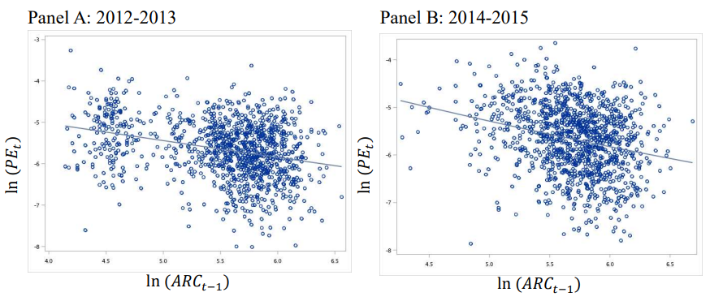
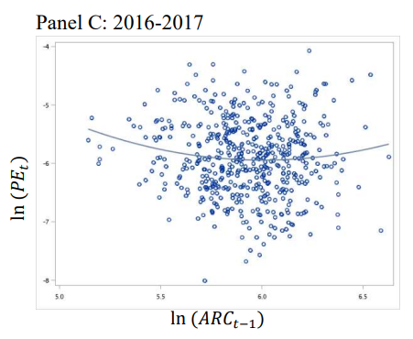
Accounting reporting complexity (ARC) and pricing error (PE)
Comparing the ARCs between Panels A, B, and C, we see an increase in ARC over time. The average XBRL tags are 252.8, 299.5, and 374.9, respectively.

Slide 15
Data
Sample period from 2011 to 2017.
Financial statement data from Compustat
Stock return data from CRSP Prices
Institutional holdings data from the Thomson's 13F database
Intraday transaction data from NYSE’s Trade and Quote (TAQ) database.
XBRL data from firms' 10-K filings in the SEC's Electronic Data Gathering, Analysis, and Retrieval (EDGAR) database.

Slide 16
Model
Size is the market value of equity.
Holdings is the fraction of holdings by institutional investors.
LIQ is a liquidity measure, defined as -1 * Amihud’s (2002) illiquidity measure.
Price is the firm’s stock price.
VP is the standard deviation of transaction prices.
NASDAQ is a dummy variable that equals 1 if the stock is listed on the NASDAQ exchange.

Slide 17
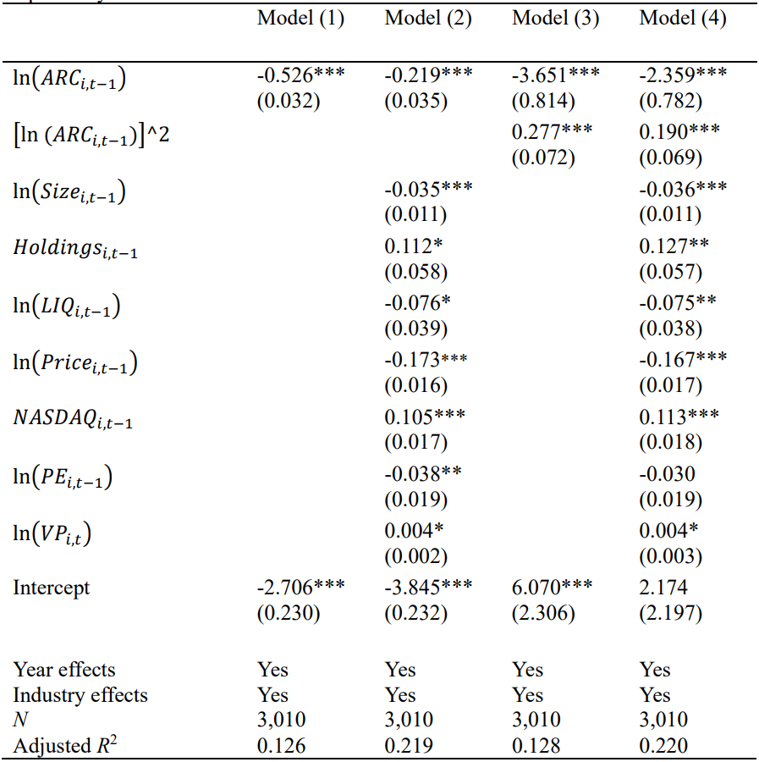
Main Results

Slide 18
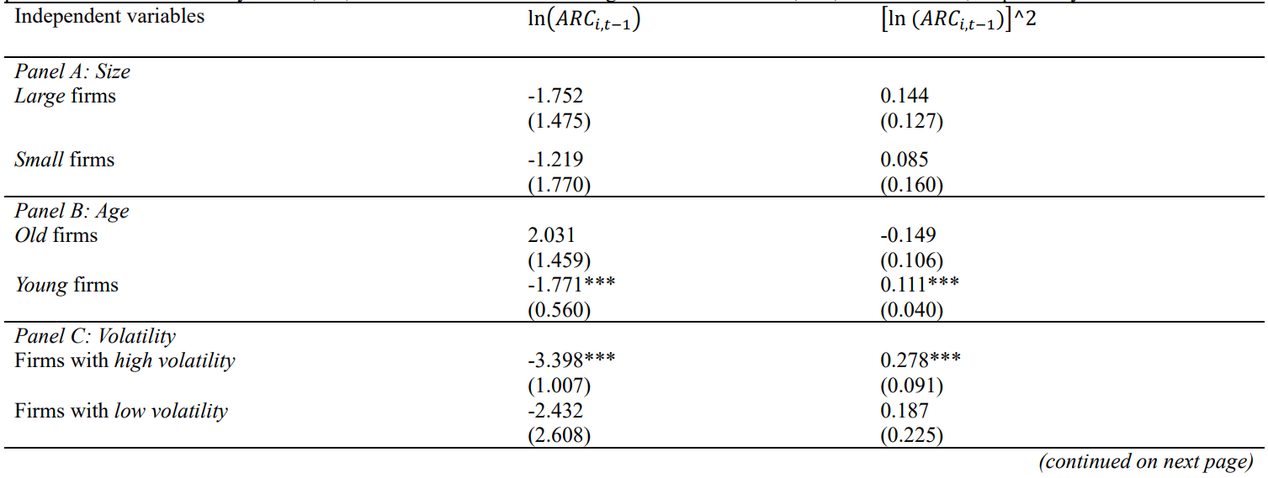
Difficult-to-value firms have a more significant impact
We use Baker and Wurgler's (2006) classification for difficult-to-value firms (in the red block).
The nonlinear relations are not significant for any easy-to-value firms.

Slide 19
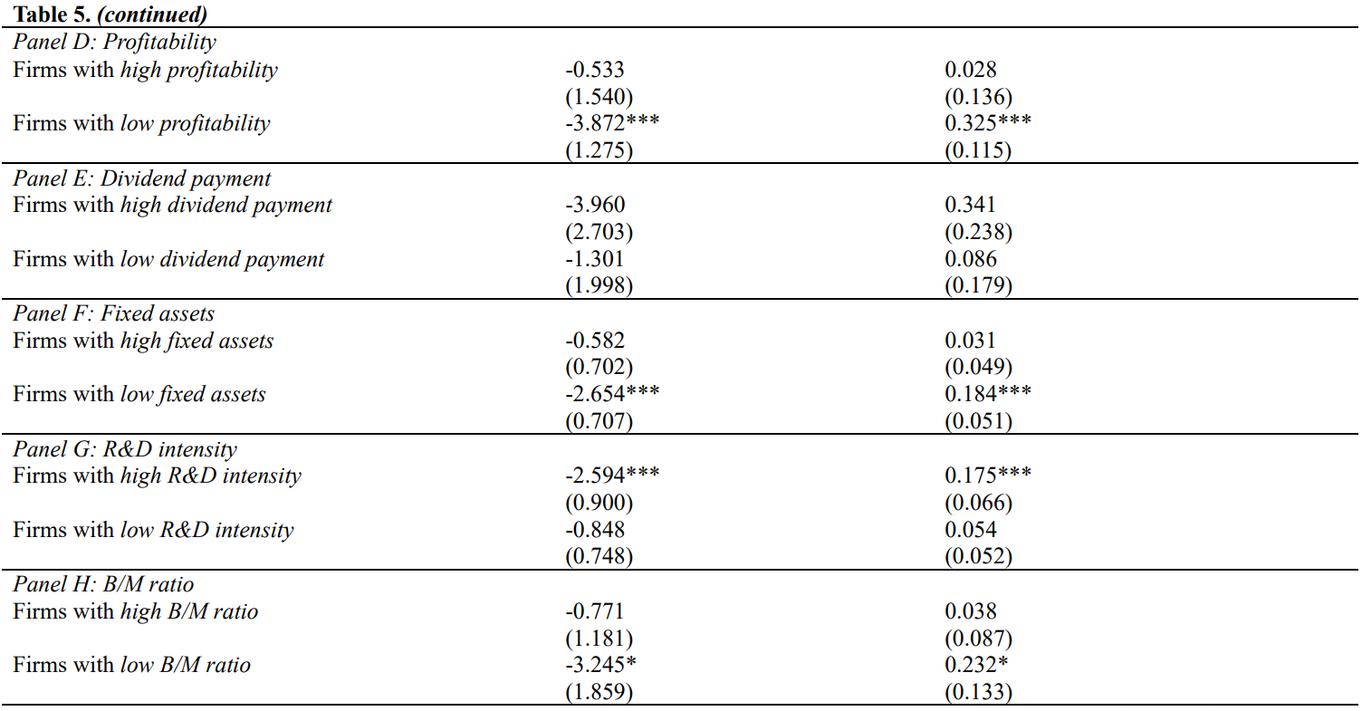

Slide 20
Alternative ARC measures
ARC_All: Total number of monetary XBRL tags, including non-repeating and repeating tags.
ARC_Numerical: The numbers of monetary XBRL tags and of non-monetary ones (e.g., percentages, ratios, number of shares).
With controls
With controls
With controls
With controls

Slide 21
Reverse causality issues
As Ferrira et al. (2011) point out, the informational efficiency of stock prices may determine firms' board structure, which would influence their information disclosure policy, a reverse causality.
We use CEO tenure as our instrumental variable, which provides a proxy for the CEO's influence on board structures. Hermalin and Weisbach (1998), Baker and Gompers (2003) and Boone et al. (2007).

Slide 22
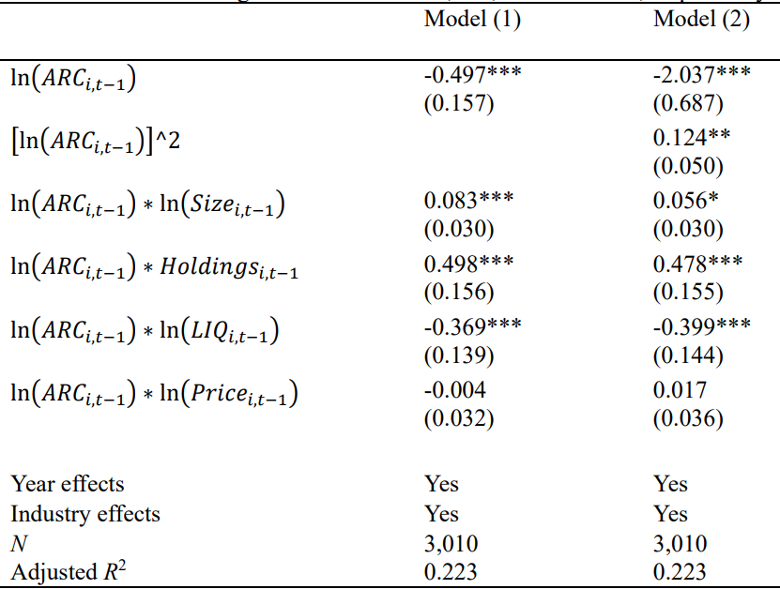
Omitted variable bias
Omitted variables (Lang and Lundholm, 1996).
Corporate disclosure variable may be correlated with firm characteristics, in a way that our empirical model does not capture.

Slide 23
The effects of EDGAR Implementation on the information environment (additional test)
Staggered mandatory implementation of the EDGAR system from 1993 to 1996 as a shock to information dissemination technologies (Gao and Huang, 2020),
The positive impacts of the EDGAR implementation on price efficiency would be more significant for difficult-to-value firms.

Slide 24
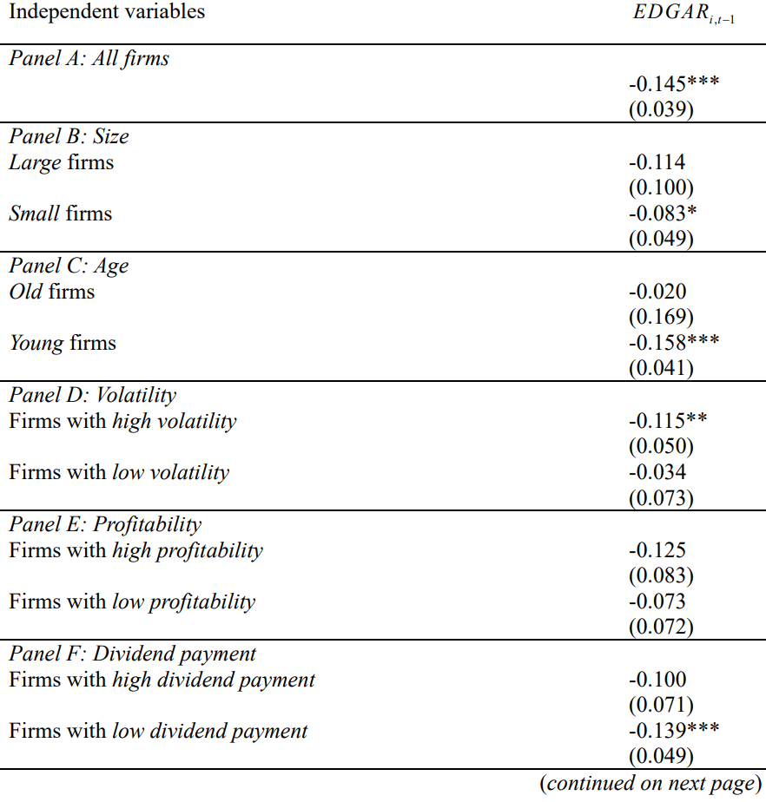
The effects of EDGAR Implementation

Slide 25
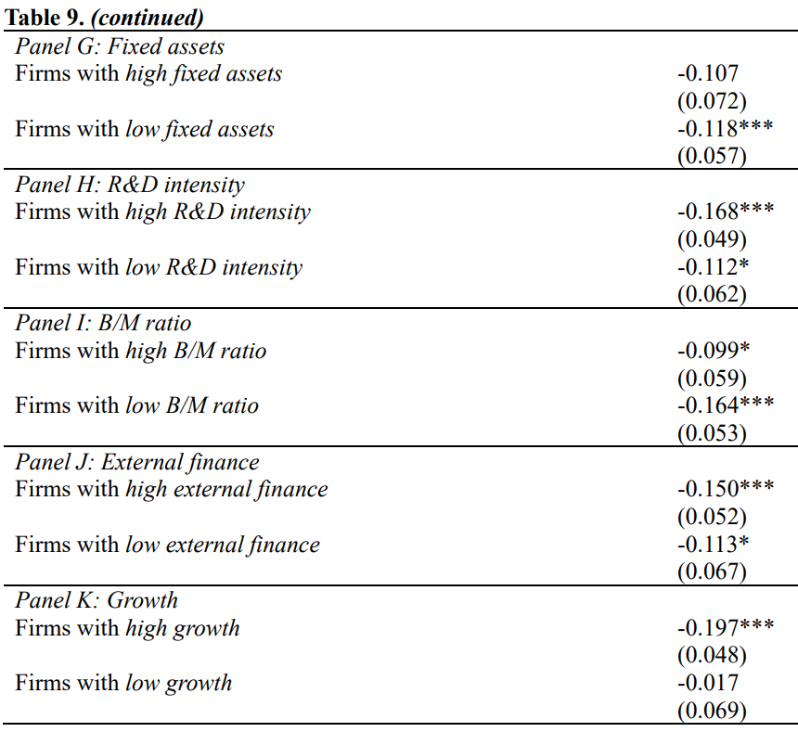

Slide 26
Conclusion
A non-linear relationship between information disclosures and price efficiency.
More accounting disclosures initially increase stock price efficiency, but after a certain point (i.e., approximately 496.7 XBRL tags), they decrease it.
Firm characteristics also influence this information disclosure-price efficiency relationship. For hard-to-value firms, it matters more.
These findings are important for policymakers designing disclosure requirements.
More information is not always better.

Slide 27
Thank you

