Slide 1
Do Political Preferences Shape Retail Investors’ Decisions? Evidence from the Taiwan Stock Market
Pei-Shih Weng & Weng Ian Hoi
National Sun Yat-sen University

Slide 2
Introduction
This study explores the correlation between political preferences and trading decisions among Taiwanese retail investors.
Utilizes detailed stock transaction data and electoral statistics to analyze the impact of voting behavior on financial decision-making.
Finds significant evidence that political affiliations, particularly towards China-friendly policies, influence investment tendency in China concept stocks.

Slide 3
Research Questions &Key Findings
Research Questions:
Political preference → Retail Investors’ attention to stocks?
Higher stock attention → Lead to overtrading?
Overtrading→ Better or worse profit performance?
Trading performance → Future political behavior?
Key Findings
Investors in areas with a clear preference are more likely to trade related stocks in large quantities than investors outside these areas.
Politically influenced investment patterns can cause financial losses, suggesting that investment decisions driven by political preferences may be less rational and less profitable.
Investment results will not significantly affect investors’ future voting behavior.
Notes:
Do political preferences affect retail investors’ attention to stocks?

Slide 4
Advantages of This Study
Data advantage: There are detailed election data and securities trading data for each county and city. Because of these two data, we can connect them to study the correlation between elections and trading behavior.
Unique political Status: Taiwan, as a democratic country in Asia, its special political attributes and ecology, make it easier to define political preferences ( China-friendly or not).
Fills the gap by linking voting behavior to investment decisions at the individual level in a non-Western context.
Notes:
-Taiwan's unique position as a vibrant democracy within Asia, offering a compelling case for examining the interplay between political dynamics and financial markets.
--wediscusses the strategic economic role of Taiwan, especially its semiconductor industry's global significance, and how internal political shifts, notably those affecting cross-strait relations with China, impact international trade policies and geopolitical relations.
This study fills the gap by linking voting behavior to investment decisions at the individual level in a non-Western context, offering insights into behavioral finance's global applicability.

Slide 5
Related Studies
Behavioral Finance: Theories from Barber and Odean (2001), and Graham and Kumar (2006) highlight individual investors' heterogeneous behaviors, influenced by their beliefs and expectations about market dynamics.
Political Preferences: Studies by Kaustia & Torstila (2011) and Hong & Kostovetsky (2012) show personal political beliefs significantly influence economic decisions, laying groundwork for exploring political biases in investment.
Gap in Literature: Previous studies focused on market-level analysis within the US and European contexts, leaving a gap in understanding the direct effect of political preferences on individual trading behavior, especially in Asian markets like Taiwan.

Slide 6
Hypotheses Development
Hypothesis 1 (H1)
Investors in cities or counties with a strong KMT preference are more inclined to trade China concept stocks before elections, as inferred from voting patterns.
Hypothesis 2 (H2)
Investment decisions driven by investors’ political preferences are more likely to be sentimental, leading to poorer investment performance.

Slide 7
Data and Methodology
Data Sources:
Trading data sourced from TWSE, focusing on 927 branches catering to retail investors, covering 76 brokerage firms from January 2013 to December 2018, totaling nearly 460 million observations.
Additional financial variables are obtained from TEJ.
Simplified criteria used to select 196 China concept stocks based on China‘s economic policies, along with election data from the Central Election Commission for 2014 and 2018 mayoral elections and the 2016 presidential election, leveraging party vote (KMT vs DPP) percentages as proxies for political preferences.
Methodology:
Referring to Bui et al. (2022), aggregating dollar trading volumes (buy or sell) of China concept stocks from branch level to city level.
Considering average buying and selling prices along with closing prices to calculate k-day buying and selling return rates post-trading day.
Notes:
Data Collection and Variable Construction: Utilizing a detailed dataset of election results and stock trading records, focusing on China concept stocks, we adopted a two-step procedure proposed by Bui et al. (2022) to aggregate the dollar trading volume of stocks from the branch level to the city level. This involves further aggregation from the stock level to the city level for both buying and selling trading values.
Analysis of Investment Behavior: Another variable related to trading data was defined by calculating the net trading volume of each stock by every securities firm branch in Taiwan on each trading day into buying and selling portfolios. This calculation also involves using the average buying and selling price and the closing price to calculate the k-day buying and selling return rate of stock after the trading day.

Slide 8
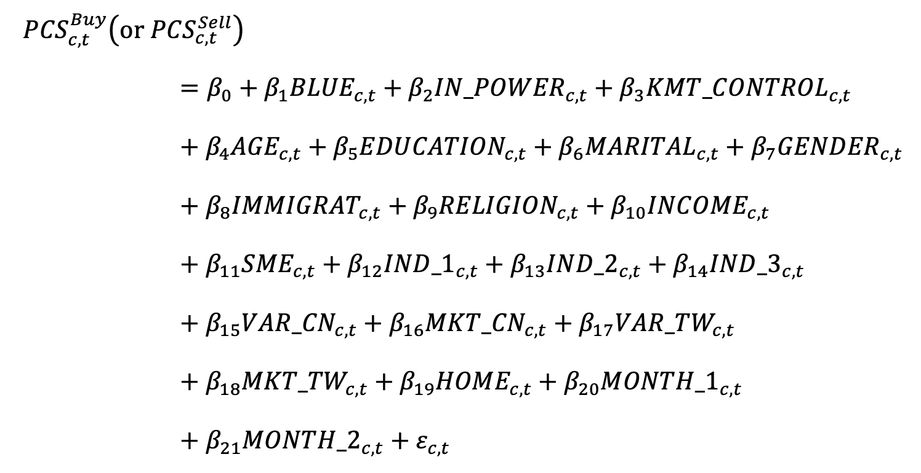
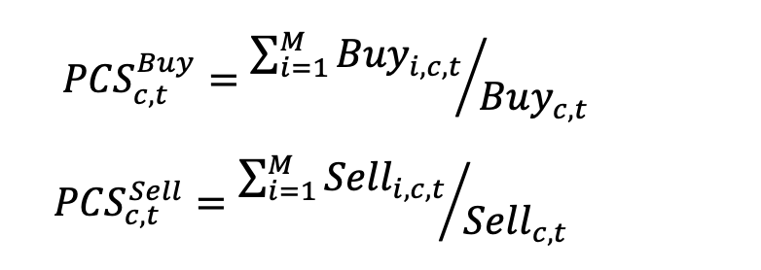
Data and Methodology
Main variables:
The regression model:
Notes:
Election Data and Multivariate Regression Models: A series of multivariate regression models were estimated, with the percentage of China concept stock transactions serving as the dependent variable. The indicator variable BLUE (representing the KMT) was used as the primary independent variable, which is a dummy variable indicating that in an election, if the KMT's vote count exceeds the DPP's in a city/county area, it is set to 1, otherwise, it is set to 0. Other variables related to election data were also considered.
${In_POWER}_{c,t}$is a dummy variable representing whether the KMT is the ruling party in the county (city) area before the election. If the KMT was in power, this variable is set to 1; if not, it’s set to 0. ${KMT_CONTROL}_{c,t}$ signifies the total number of times since 2000 till that election year when the KMT had won the local executive elections in that city/county, and the presidential elections where the KMT received more votes than the DPP. The higher this number, the more influence the KMT had in that area over time, reflecting its success in winning leadership roles both locally and nationally.

Slide 9
Influence of Political Preferences on Trading Decisions
Table 4
Voting Behavior and Trading Decisions
Interest Coefficient: 𝛽1
Finding: Significantly positive 𝛽1 indicates a higher tendency to trade China concept stocks in KMT-favored areas, supporting Hypothesis 1.
Buying and Selling Trends
Election Periods Analyzed: Presidential election of 2016, mayoral and county magistrates’ elections of 2018.
Results: Significant and consistent with Table 4's findings during specific elections.
Net trading volume of China Concept Stocks
Specific Outcome: 𝛽 significant and positive only during the presidential election of 2016.
Implication: In KMT-favored areas, investors tend to buy more China concept stocks than they sell.
Notes:
Table 4 presents the effects of voting behavior on trading decisions, utilizing the
entire sample period. Our coefficient of interest in this model is 𝛽 . As reported , we (
find a significantly positive 𝛽 indicates that in an election, if the level of support for (
the KMT in a county (city) area exceeds that for the DPP, investors in that area, on average, tend to trade more China concept stocks. These findings support Hypothesis 1.
-
Table 5 and Table 6 present the results of analyzing the tendency of purchasing and selling China concept stocks, respectively. Overall, the results are significant and consistent with the findings in Table 4, but only during the presidential election of 2016 and the mayoral and county magistrates’ elections of 2018.
-Table 7 focuses solely on the net acquisition of China concept stocks. This outcome slightly differs from the previous two, with β1 being significant and positive only for the presidential election of 2016. This outcome indicates that in an election, if the level of support for the KMT exceeds that for the DPP in a particular county (city) area, then investors in that area, on average, tend to purchase a higher proportion of China concept stocks than they sell.
--when a county (city) region initially governed by the DPP switches to KMT governance after an election, investors in that area, on average, tend to buy more China concept stocks. Conversely, if a county (city) region initially under KMT governance switches to DPP governance after the election, investors in that area, on average, tend to buy fewer China concept stocks, aligning with Hypothesis 1.

Slide 10
Influence of Political Preferences on Trading Decisions
Table 5 and Table 6 present the results of analyzing the tendency of purchasing and selling China concept stocks for each election, respectively.
Table 7 focuses solely on the net acquisition of China concept stocks.
Table 8 displays the impact of political party rotations in counties (cities) on the post-election buying (selling) of China concept stocks in those areas.
Overall, the results are significant and consistent with the findings in Table 4, and strongly supporting Hypothesis 1.
Notes:
Table 4 presents the effects of voting behavior on trading decisions, utilizing the
entire sample period. Our coefficient of interest in this model is 𝛽 . As reported , we (
find a significantly positive 𝛽 indicates that in an election, if the level of support for (
the KMT in a county (city) area exceeds that for the DPP, investors in that area, on average, tend to trade more China concept stocks. These findings support Hypothesis 1.
-
Table 5 and Table 6 present the results of analyzing the tendency of purchasing and selling China concept stocks, respectively. Overall, the results are significant and consistent with the findings in Table 4, but only during the presidential election of 2016 and the mayoral and county magistrates’ elections of 2018.
-Table 7 focuses solely on the net acquisition of China concept stocks. This outcome slightly differs from the previous two, with β1 being significant and positive only for the presidential election of 2016. This outcome indicates that in an election, if the level of support for the KMT exceeds that for the DPP in a particular county (city) area, then investors in that area, on average, tend to purchase a higher proportion of China concept stocks than they sell.
--when a county (city) region initially governed by the DPP switches to KMT governance after an election, investors in that area, on average, tend to buy more China concept stocks. Conversely, if a county (city) region initially under KMT governance switches to DPP governance after the election, investors in that area, on average, tend to buy fewer China concept stocks, aligning with Hypothesis 1.

Slide 11
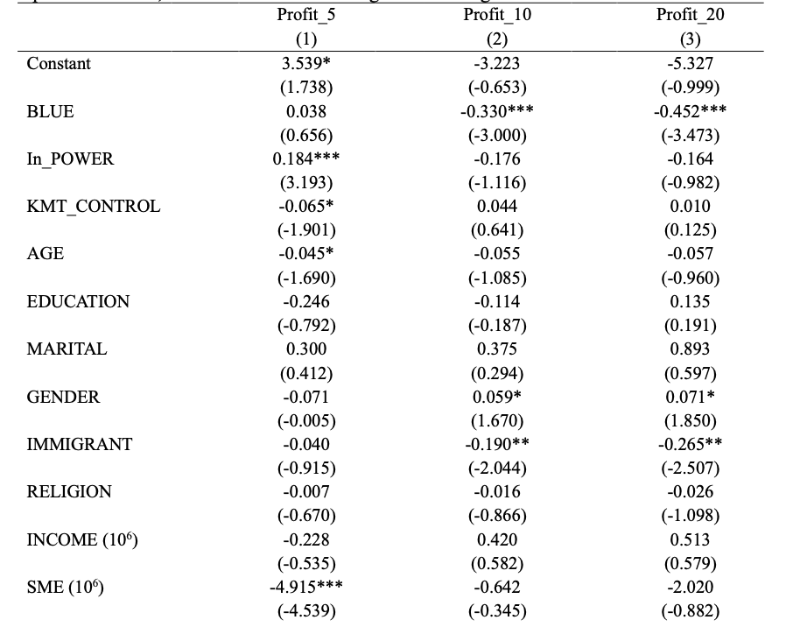
Performance of Trading China Concept Stocks During Election Period
Table 9 provides critical evidence on the impact of political preferences on the trading performance of China concept stocks.
Influence of Political Preferences:
Trading decisions influenced by political preferences, especially pro-KMT orientations, are linked to poorer short-term financial outcomes. The Results support H2.
Rationality vs. Emotion in Trading Decisions:
The observed trading performance suggests that investments driven by political biases may not be based on rational financial decision-making.
Indicates a shift towards emotionally influenced trading behavior among investors with strong political affiliations.
Notes:
Focusing on the performance outcomes of trading China concept stocks, Table 9 presents a critical insight into our second hypothesis. It reveals that trading decisions influenced by political preferences, notably those aligning with the KMT, often culminate in poorer short-term financial performance. This outcome suggests that investments driven by political biases may lack the rational basis typically associated with sound financial decision-making, pointing towards a more emotionally influenced trading rationale.

Slide 12
Does Trading Performance Affect Voting Behaviors in the Next Election?
Investigating Political Influence:
Explores if trading outcomes of China concept stocks affect future political preferences and voting behaviors.
Find that investors' political leanings and voting behavior remain unaffected by their investment performance in these stocks. This consistency aligns with previous literature, suggesting that individuals' political preferences tend to remain stable over time.

Slide 13
Robustness Tests
Alternative Election Data for Robustness Tests:
Utilized municipal, county council (2014, 2018), and legislative council (2016) elections data to reassess the study's conclusions.
Findings:
Found no significant impact of political preferences on trading decisions or performance using this alternative dataset, contrasting with initial results based on mayoral and presidential election data.
Highlighted the need for further research with mayoral, gubernatorial, and presidential data or refined electoral variable definitions for municipal and council elections to accurately capture political preference effects on market behavior.

Slide 14
Conclusions
Political affiliations, notably a preference for the KMT, significantly influence investors’ trading behaviors, particularly towards China concept stocks, highlighting the impact of political dynamics on financial market behavior.
Show that areas with higher vote shares for China-friendly parties exhibit a stronger tendency among retail investors to trade China concept stocks. This finding demonstrates a linkage between political preferences and financial decision-making biases, aligning with the expectations of behavioral consistency.
Indicates that a propensity to trade China concept stocks leads to poorer short-term trading performance, suggesting that such politically driven investment decisions may be more emotionally influenced than rational.
Enriches the knowledge of the underlying factors that influence retail trading behavior and emphasizes the significance of examining financial investment decisions from a social perspective.

Slide 15
Thank you
Comments are welcome

