Slide 1
Revised KMV Model using Herding Measurement in the Chinese Loan Market
Yongshang Liu · Sunghwan Kim (Kyungpook National University)

Slide 2
1
Introduction
This study aims to improve the traditional KMV model for assessing corporate default risk.
Methodology: The study optimizes short-term and long-term debt weights using gradient descent to determine the best default point.
Data and Matching Approach: The research uses panel data with financial and stock data, ensuring data symmetry by PSM matching non-defaulted firms with defaulted firms. This ensures robust comparisons and balanced datasets.
Performance Evaluation: Model performance is assessed using confusion matrices, AUC (Area Under the ROC Curve), and PR (Precision-Recall) curves.

Slide 3
2
Literature Review
1. Default Prediction
(1) Early Studies:
Beaver (1966): Compared the financial characteristics of distressed firms and healthy firms.
Altman (1968, 1996): Introduced the Multiple Discriminant Analysis (MDA) method.
(2) Probit/Logit Models:
Ohlson (1980): Used the Probit model for prediction.
Zmijewski (1984): Applied the Logit model.
(3) Artificial Neural Networks (ANN):
Odom and Sharda (1990): First applied Artificial Neural Networks for default prediction, outperforming MDA.
(4) Survival Analysis:
Baldwin and Gorecki (1990) & Mata and Portugal (1994): Employed survival analysis models to explore corporate survival risks.
Characteristics

Slide 4
2
Literature Review
1. Default Prediction
(5) Economic/Industry Factors:
Agarwal and Gort (1999): Investigated the impact of economic cycles and industry factors on default risk.
Honjo (2000): Analyzed internal and external causes of corporate failure.
(6) Advanced Models:
Campbell et al. (2008): Used a multinomial logit model to predict multi-period default probabilities.
Tian et al. (2015): Applied the LASSO variable selection method to improve prediction performance.
(7) Deep Learning Models:
Mai et al. (2019): Demonstrated that deep learning models outperform traditional machine learning models.
Arratia and Sepúlveda (2019): Applied Convolutional Neural Networks (CNNs) to enhance prediction accuracy.
Characteristics

Slide 5
2
Literature Review
2. KMV and Revised KMV Models
(1) Foundational Work: Merton Model and Early Extensions
Merton (1974): Introduced the contingent claims model, treating equity as a call option on a firm's assets, forming the basis of structural credit risk modeling.
Black and Cox (1976): Added constraints on refinancing to the model.
Geske (1977): Incorporated compound options for handling multiple payment obligations.
Turnbull (1979): Refined the model by including corporate taxes and bankruptcy costs.
(2) Practical Applications:
Marcus and Shaked (1984): Assessed the actuarial fairness of FDIC deposit insurance using the DD model.
KMV and Moody's (1974, commercialized in 2002): Developed practical tools for credit risk assessment based on Merton’s framework (Kealhofer, McQuown, Vasicek, 2001).
Characteristics

Slide 6
2
Literature Review
2. KMV and Revised KMV Models
(3) Critiques and Enhancements:
Sobehart and Keenan (1999, 2002), Falkenstein and Boral (2001): Critically assessed the model's predictive limitations.
Stein (2000), Sobehart and Stein (2000): Highlighted deficiencies and proposed refinements to address its weaknesses.
(4)Predictive Power
Duffie, Saita, and Wang (2007): Demonstrated the significant predictive capability of Merton DD in forecasting default term structures.
Gropp et al. (2006): Found DD moderately effective in predicting bank downgrades over a 12–18 month horizon.
Bharath and Shumway (2008): Highlighted DD’s utility for forecasting defaults but noted its limitations as a sufficient statistic.
Harada et al. (2010): Observed that DD rises significantly only shortly before bank failures, limiting its early warning capability.
Coffinet et al. (2010), Castrén and Kavonius (2009): Found similar trends, showing DD increases comparatively late during financial crises.
Characteristics

Slide 7
2
Literature Review
2. KMV and Revised KMV Models
(5) Enhancements and Broader Applications
Jessen and Lando (2015): Improved DD’s ranking effectiveness for default probabilities with a volatility adjustment under stochastic conditions.
Islam et al. (2022): Provided evidence linking firm-level political risk to DD, expanding the model's application in understanding credit risk dynamics.
Zhang (2022): Confirmed the KMV model’s strong credit risk identification ability, emphasizing the relationship between lower average DD and higher default risk.
Characteristics

Slide 8
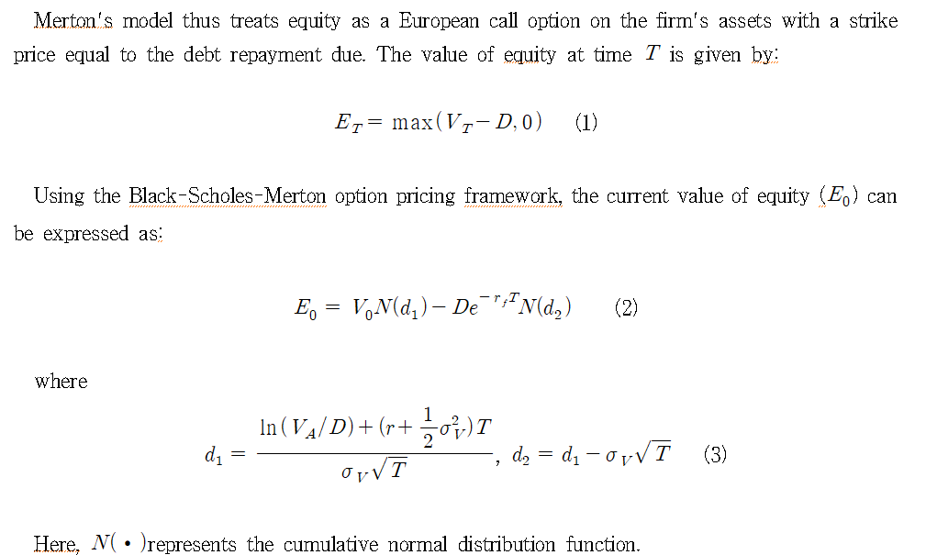
3
Ⅲ. Model Introduction
Introduction to the KMV Model

Slide 9
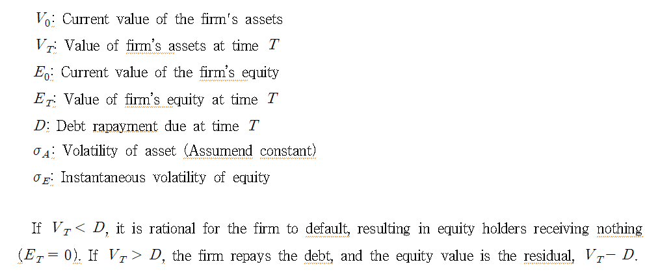
3
Ⅲ. Model Introduction
Introduction to the KMV Model

Slide 10
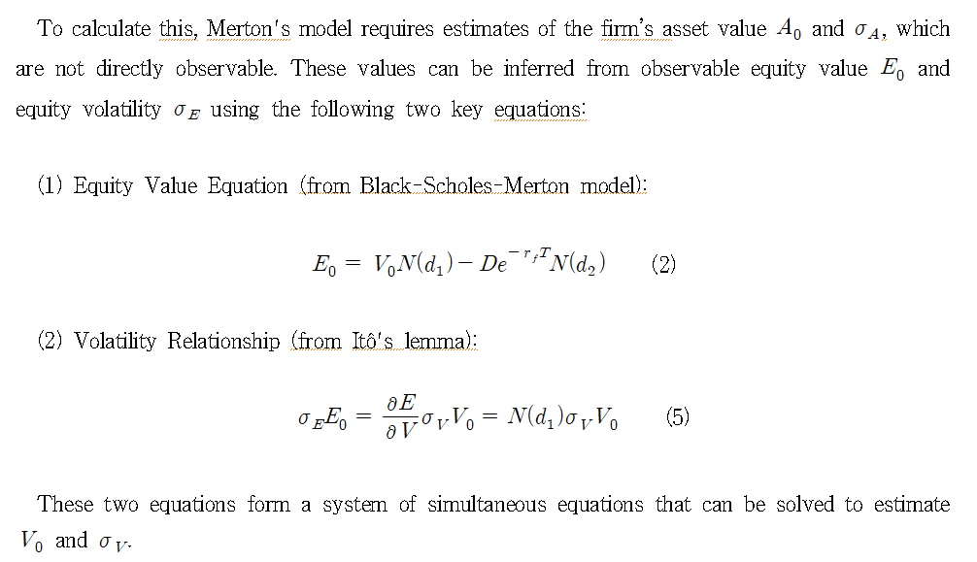
3
Ⅲ. Model Introduction
Introduction to the KMV Model

Slide 11
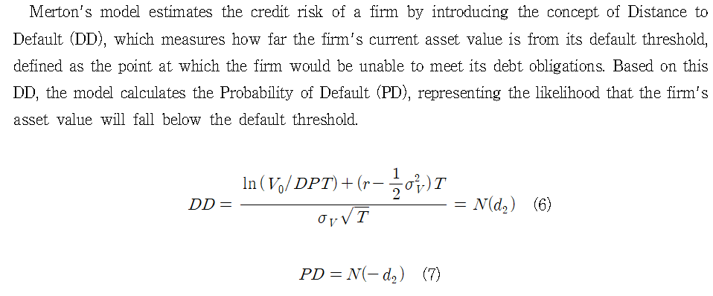
3
Ⅲ. Model Introduction
Introduction to the KMV Model

Slide 12
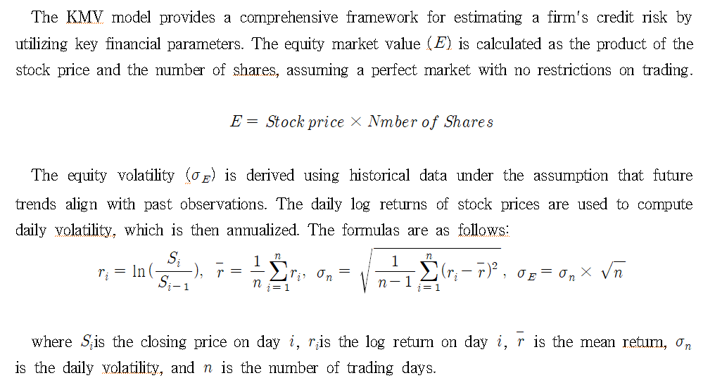
3
Ⅲ. Model Introduction
2. KMV Model Parameter Selection

Slide 13
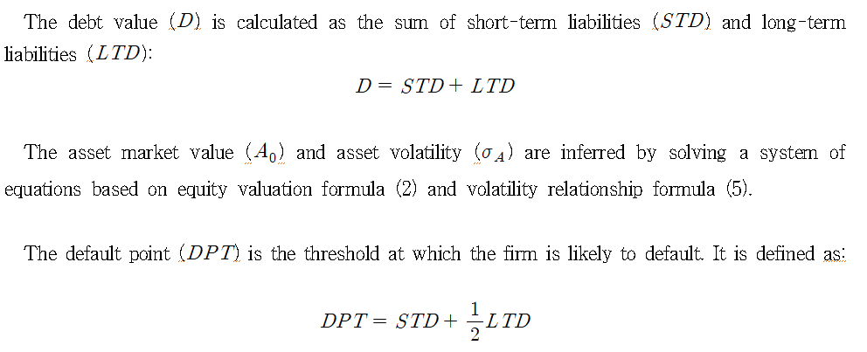
3
Ⅲ. Model Introduction
2. KMV Model Parameter Selection

Slide 14
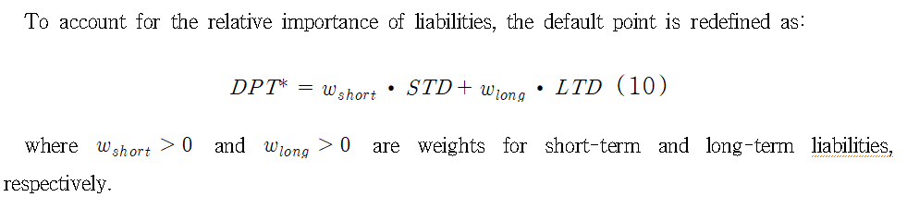
3
Ⅲ. Model Introduction
3. Revised KMV Model Parameter Selection

Slide 15
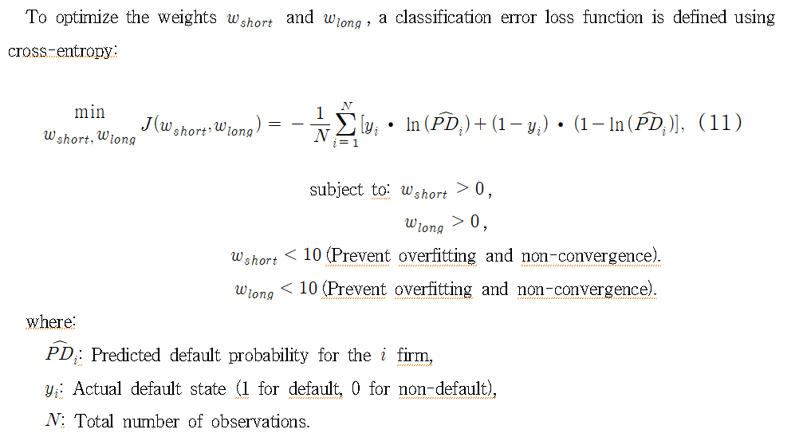
3
Ⅲ. Model Introduction
3. Revised KMV Model Parameter Selection

Slide 16
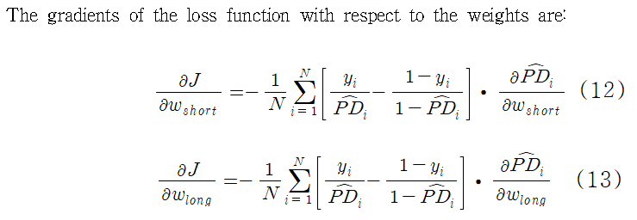
3
Ⅲ. Model Introduction
3. Revised KMV Model Parameter Selection

Slide 17
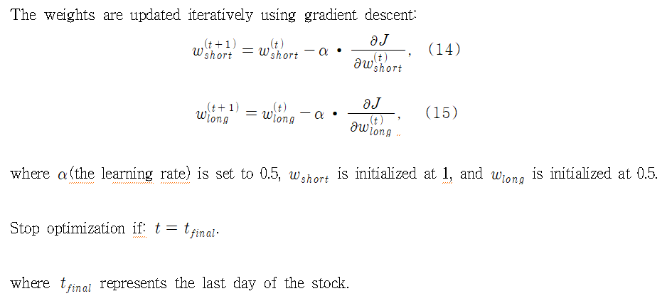
3
Ⅲ. Model Introduction
3. Revised KMV Model Parameter Selection

Slide 18
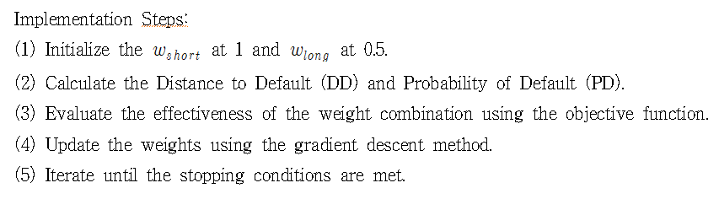
3
Ⅲ. Model Introduction
3. Revised KMV Model Parameter Selection

Slide 19
4
IV. Empirical Analysis
1. PSM Model Sample Selection
This study employs data on stock prices, financial performance, and bankruptcy reorganizations of listed companies in China from 2018 to 2023. The data is sourced from CSMAR. As of December 31, 2023, there were 5,113 A-share listed companies in the Chinese domestic stock market, of which 126 were involved in bankruptcy reorganizations. Considering the distinct operational mechanisms of the financial industry and the complexities of the Chinese real estate sector in recent years, these two industries have been excluded from our sample. Our sample, covering the period from 2018 to 2023, includes a total of 216 A-share listed companies, among which 108 companies underwent bankruptcy reorganizations.

Slide 20
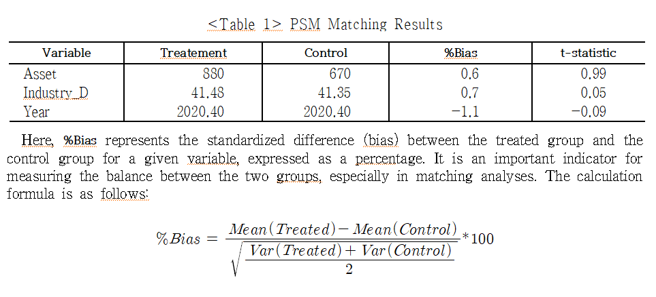
4
IV. Empirical Analysis
1. PSM Model Sample Selection
<Table 1> presents the results of the Propensity Score Matching (PSM) analysis, comparing the treatment group and control group, each consisting of 108 observations. The variables Asset, Industry_D, and Year demonstrate close alignment between the two groups after matching.

Slide 21
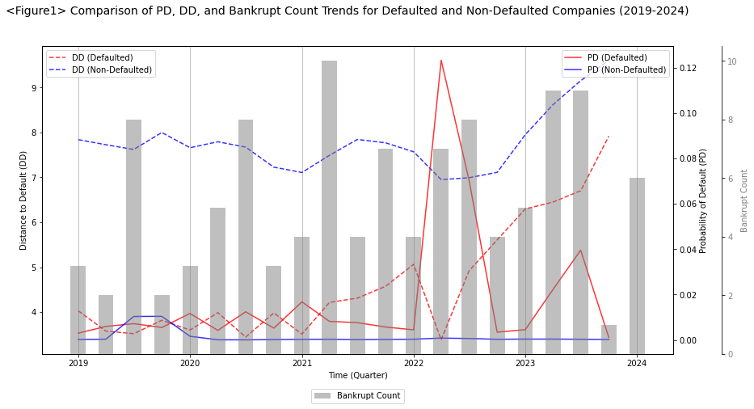
4
IV. Empirical Analysis
4. Empirical Analysis

Slide 22
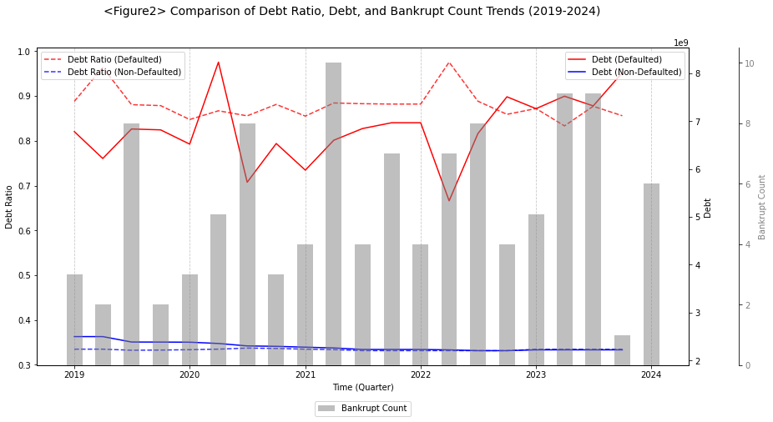
4
IV. Empirical Analysis
4. Empirical Analysis

Slide 23
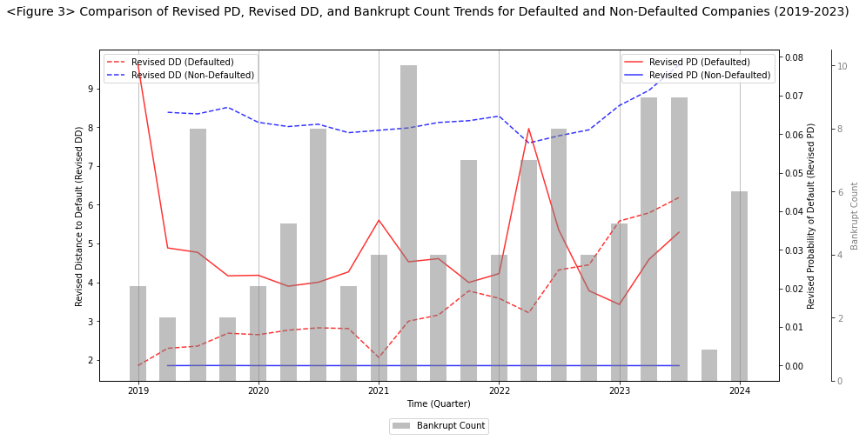
4
IV. Empirical Analysis
4. Empirical Analysis

Slide 24
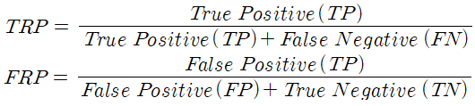
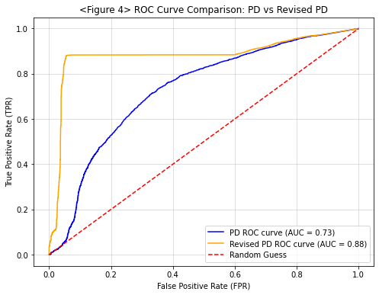
4
IV. Empirical Analysis
4. Empirical Analysis
<Figure 4> shows that the ROC curve reflects the model's classification performance at different thresholds by plotting the relationship between the True Positive Rate (TPR) and the False Positive Rate (FPR). The closer the AUC is to 1, the better the model's performance

Slide 25
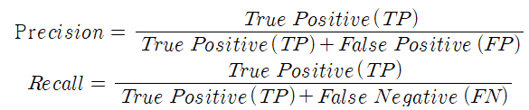
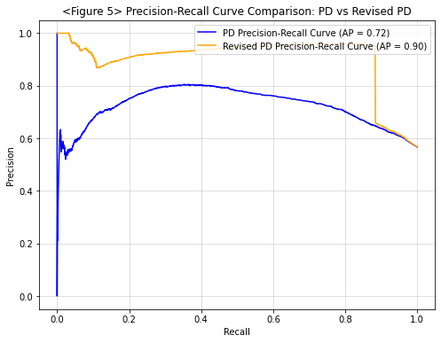
4
IV. Empirical Analysis
4. Empirical Analysis
<Figure 5> shows that the Precision-Recall curve demonstrates the performance improvement of our revised model over the original one. The original model achieved an AP of 0.72, while the revised model significantly increased it to 0.90.

Slide 26
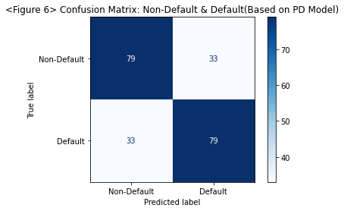
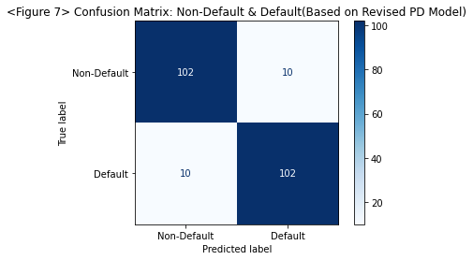
5
IV. Empirical Analysis
4. Empirical Analysis
<Figure 6> shows moderate performance, with accuracy and precision both around 70.54%. In contrast, <Figure 7> demonstrates outstanding performance, with accuracy and precision both improving to 91.07%, significantly reducing false positives and false negatives, and enhancing classification performance.

Slide 27
5
  V. Conclusion
This study focuses on optimizing the KMV model by introducing adjustable weights for short-term and long-term liabilities, aiming to improve the accuracy and flexibility of corporate default prediction.
By redefining the Default Point (DPT) as a weighted combination of short-term and long-term liabilities, the model accounts for the relative importance of these liability types. Using gradient descent, the optimal weights were identified, resulting in a revised (DP∗) and an optimized Distance to Default(DD*)
The proposed approach enhances the KMV model in the following ways:
(1) Improved Predictive Accuracy: By optimizing the liability weights, the model better aligns with observed default probabilities, improving its classification performance.
(2) Dynamic Adaptability: The flexible weighting framework allows the model to adjust to firm-specific or market-specific conditions, providing a more realistic representation of credit risk.
(3) Practical Application: The optimized KMV model offers financial institutions a more robust tool for evaluating corporate default risk, especially in dynamic and complex financial environments.

Slide 28
6
  VI. Limitation
This study has a limitation in that it uses actual default probabilities to infer optimized liability weights, which inherently adjusts weights to align with defaulted and non-defaulted firms, potentially reducing the model’s generalization capability. Future research should address this by distinguishing between training and testing datasets to improve robustness.
Additionally, the model can be extended by incorporating industry-specific characteristics, macroeconomic variables, spatiotemporal default contagion, or dynamic adjustment mechanisms for liability weights to enhance its applicability and predictive accuracy.

Slide 29
Thank You~

