Slide 1
Text-Based Corporate Default Prediction with BERT Models
Tae Seon Yoon¹ (SKKU) and Byung Hwa Lim² (SKKU)
2024년 한국금융공학회 추계학술대회 2024.11.29
Department of FinTech, Sungkyunkwan University, E-mail: tjs1244@g.skku.edu
Department of FinTech, Sungkyunkwan University, E-mail: limbh@skku.edu

Slide 2
Contents
1. Introduction
2. Literature Review
3. Models - BERT
4. Data
5. Synthetic Data - Gen AI (ChatGPT)
6. Result
7. Conclusion & Discussion

Slide 3
1. Introduction
Adopting machine learning models in credit risk modeling (predicting corporate defaults) widely emerges!
Accurate prediction in corporate credit risk is considered especially important in fields such as risk management, corporate lending, and credit rating (scoring).
Machine learning-based models have demonstrated exceptional performance in addressing prediction problems, including asset pricing, fraud detection, bankruptcy prediction, etc.
Many financial institutions in the United States already leverage AI techniques to measure credit risk. In Korea, institutional frameworks are also being established to support this approach.
As a result, the importance of predicting credit risk has been highlighted in the field of credit risk management, raising significant questions about how to apply these techniques effectively.

Slide 4
1. Introduction
Alternative data is necessary for the efficient prediction of a corporation’s financial distress.
Existing machine learning-based models are primarily financial data-driven, relying on structured data such as accounting, market, and macroeconomic indicators.
However, such numerical data alone cannot fully represent a company’s situation.
There may also be environments or periods where such variables do not perform effectively
It is necessary to incorporate unstructured or non-financial data into the models (multi-modal).
Diversity in form and source, sophisticated methods for utilizing new types of data
In this study, we have focused on leveraging textual data in the context of corporate default prediction.

Slide 5
1. Introduction – Motivation
Research Questions
Is it possible to predict corporate bankruptcy using text-based data?
Can we enhanced model performance by mitigating data imbalance?
Can the performance of corporate default prediction be improved through a multimodal model?
How to apply machine learning effectively to a firm’s default prediction
Listed companies in U.S. stock markets
Alternative data – textual data (MD&A)
Synthetic data – mitigate the data imbalance using Gen AI (ChatGPT)
Robust tests for subsample analysis (mid-cap companies)

Slide 6
1. Introduction – Alternative data and Gen AI
MD&A (Management's Discussion & Analysis) textual data.
SEC Regulation S-K requires firms to discuss their liquidity needs and sources in the MD&A section.
Reliability of being subject to accounting standards
Compatibility with existing datasets
Gen AI using ChatGPT to mitigate the imbalanced data problem
The imbalance data is the typical challenge faced by data-driven credit model
Using ChatGPT (3.5), we generate synthetic MD&A data to reduce the imbalance problem.
Also, EDA and focal loss function
Multimodal model
Examining a multimodal model combining traditional financial accounting data with textual data can achieve better predictive performance than existing models.

Slide 7
Contents
1. Introduction
2. Literature Review
3. Models - BERT
4. Data
5. Synthetic Data - Gen AI (ChatGPT)
6. Result
7. Conclusion & Discussion

Slide 8
2. Literature Review
Financial data-driven credit modeling (Machine learning based models)
Barboza et al. (2017): machine learning models offer a 10% improvement in predictive accuracy.
Kim et al. (2021): Focusing on sequential data could improve performance over traditional cross-sectional data.
Korangi et al. (2023): Multimodal models(accounting, market, marco data) based on sequential data.
Veganzones et al. (2018): Significant performance drops can occur in datasets with an imbalance ratio below 20% (SMOTE technique is the most effective solution)
However, a significant limitation in applying these machine-learning techniques is the heavy reliance on structured data, such as market and accounting data.
Furthermore, the data augmentation methodologies proposed in existing studies are challenging to apply to text data such as MD&A.

Slide 9
2. Literature Review
Text-based credit modeling (Focus on corporate disclosure)
Mai et al. (2019): Embed MDA data and utilize word2vec for the embedding.
Chen et al. (2023): Utilize the characteristics of 10-K text as variables (frequency of specific words, file size, and the number of sentences)
Kim et al. (2023): BERT to extract sentiment
These studies, however, are based on only a portion of the information contained in text data (e.g., sentiment analysis) and fail to fully incorporate the specific circumstances of individual companies into the predictions.
Moreover, the studies neither address the issue of data imbalance nor clearly articulate the value of multimodal models that leverage text data in the prediction process.

Slide 10
Contents
1. Introduction
2. Literature Review
3. Models - BERT
4. Data
5. Synthetic Data - Gen AI (ChatGPT)
6. Result
7. Conclusion & Discussion

Slide 11
3. Models - Embedding
BERT (Bidirectional Encoder Representations from Transformers)
BERT is a model developed by Google (Devlin et al., 2018) as a framework for NLP tasks.
Unlike Word2Vec and GloVe, BERT is designed to read text bidirectionally
Transformer: self-attention mechanism
Source: Devil et al., “BERT: Pre-training of Deep Bidirectional Transformers for Language Understanding,” 2018

Slide 12
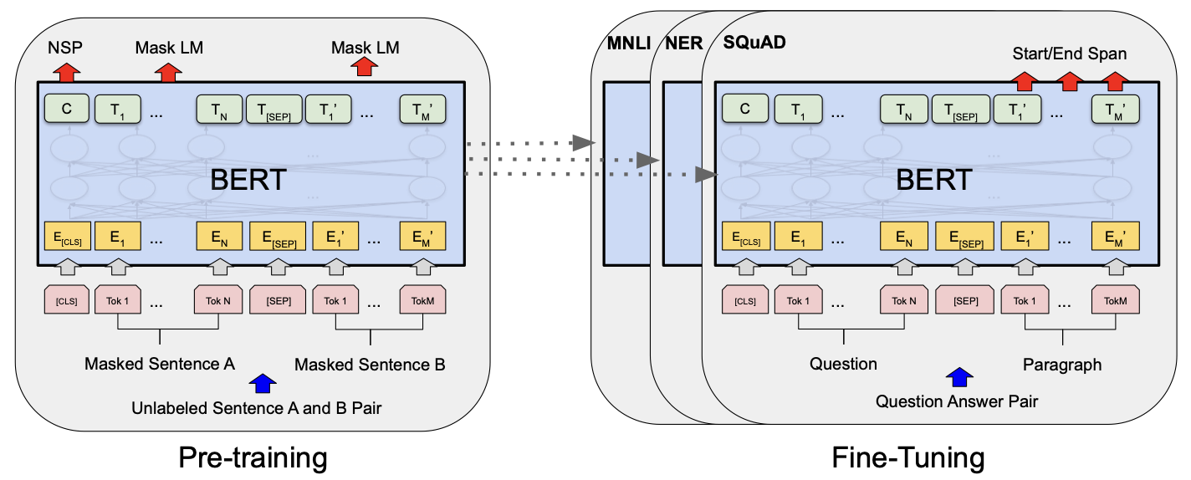
3. Models - Embedding
Source: Devil et al., “BERT: Pre-training of Deep Bidirectional Transformers for Language Understanding,” 2018
FinBERT (For finance domain)
FinBERT by ProsusAI (Araci et al., 2019): Use a large financial corpus (Financial PhraseBank by Malo et al., 2014, containing 4,841 sentences) and fine-tuned for financial sentiment classification.
FinBERT-tone by Yiyanghkust (Huang et al., 2023): Fine-tuned on 10,000 manually annotated sentences from analyst reports.

Slide 13
3. Models - Prediction models
A deep learning architecture to process sequential and high-dimensional data effectively
LSTM (Long Short-Term Memory)
A type of recurrent neural network (RNN) structure designed to capture long-term dependencies in sequential data effectively.
GRU (Gated Recurrent Unit)
Simplified version of LSTM that enables more efficient computation.
Transformer
Considers the entire sequence at once, regardless of the sequence position, and operates based on a self-attention mechanism.
TCN (Temporal Convolutional Network)
Models sequential data using convolutional neural networks.
DNN (Deep Neural Network)
The sequence information is compressed into a single sequence by averaging the individual elements.
A model that only uses the data from the last quarter (annual text data) will also be trained to compare with other models.
All models in our study have a single hidden layer.

Slide 14
Contents
1. Introduction
2. Literature Review
3. Models - BERT
4. Data
5. Synthetic Data - Gen AI (ChatGPT)
6. Result
7. Conclusion & Discussion

Slide 15
4. Data
We explore the prediction of default risk for publicly traded U.S. companies.
Financial industry firms are excluded.
Quarterly data is collected.
In this study, default is defined as instances where a company undergoes bankruptcy or liquidation, as provided by the Compustat database.
To identify these cases, we use the "DLRSN" (Research Company Reason for Deletion), selecting cases where DLRSN is 02 (Bankruptcy) or 03 (Liquidation).
Also, we used the asset footnote codes of TL or GL to identify companies in bankruptcy or liquidation.
Specifically, we focused on companies that experienced bankruptcy within a one-year period.
Predicting defaults immediately after a quarter would offer limited value in terms of implications.

Slide 16
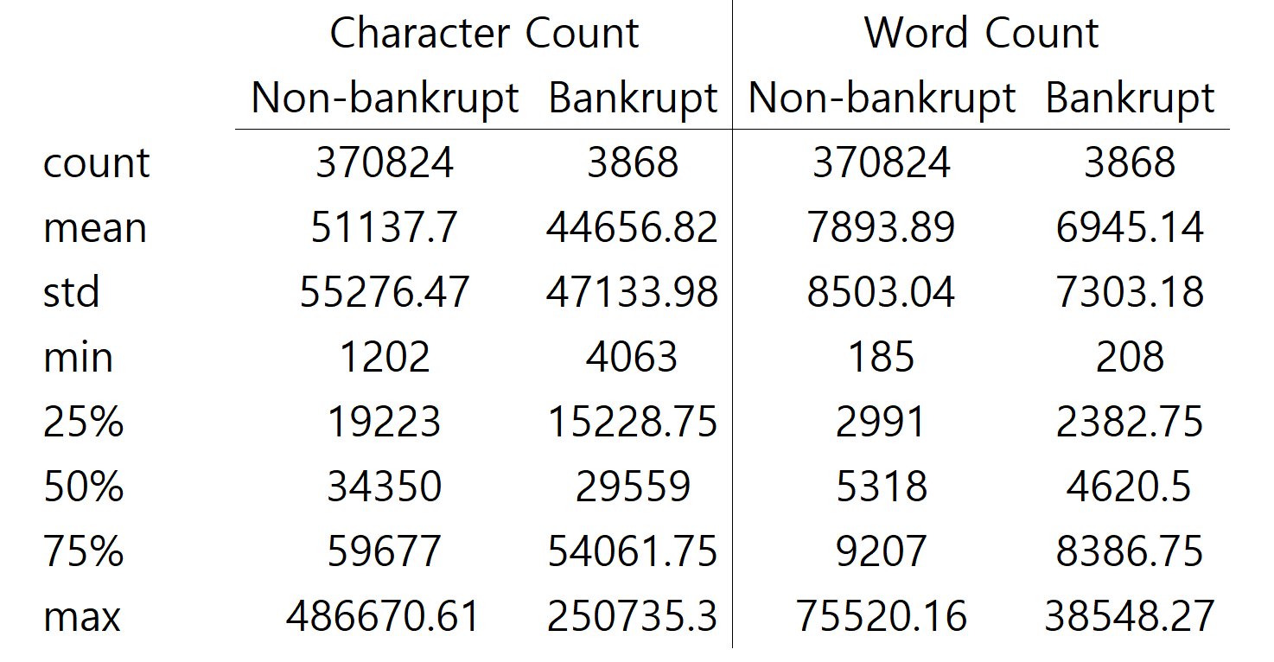
4. Data
We download 10-K and 10-Q filings in text format from the SRAF (Software Repository for Accounting and Finance) for the years 1993–2023.
Using filing patterns, we employ Python to extract the MD&A section.
To maximize data on defaulted companies, some cases are manually collected.
We have removed special characters, line breaks, and numbers

Slide 17
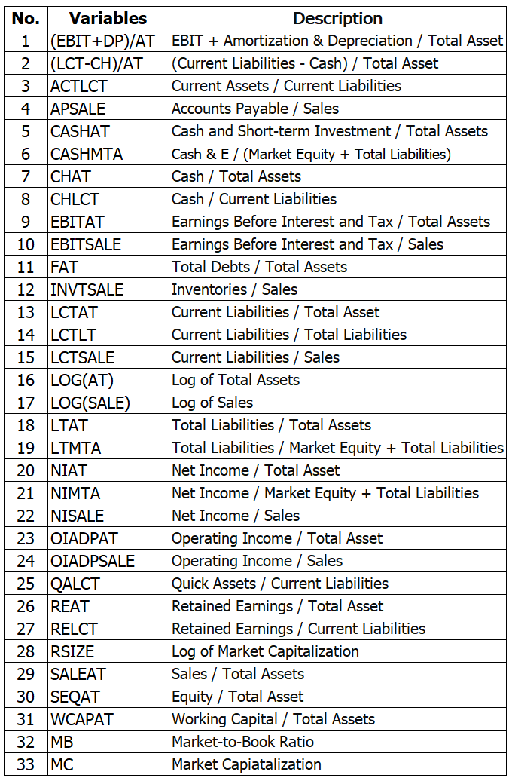
4. Data
The financial ratio for constructing the multimodal model is organized as follows.
In their study on corporate default prediction, Mai et al. (2019) compile a set of financial ratios.
We use 33 of these financial ratios in our research.
We performed standardization on the financial ratios.
Missing values are replaced with the industry median.

Slide 18
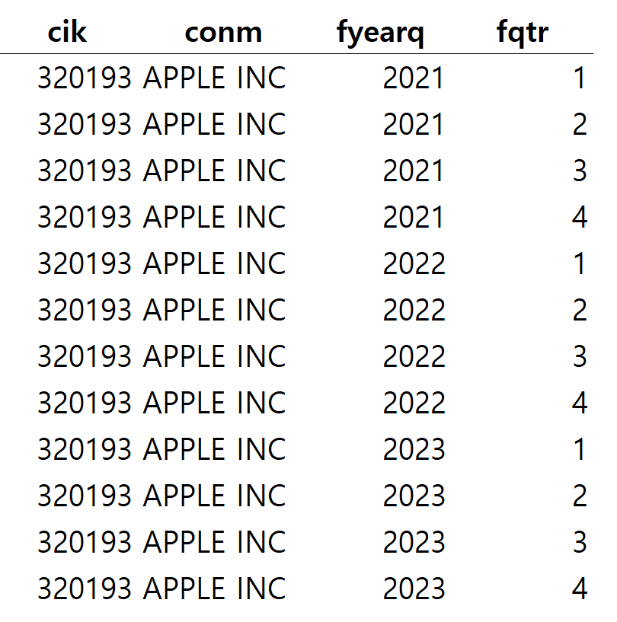
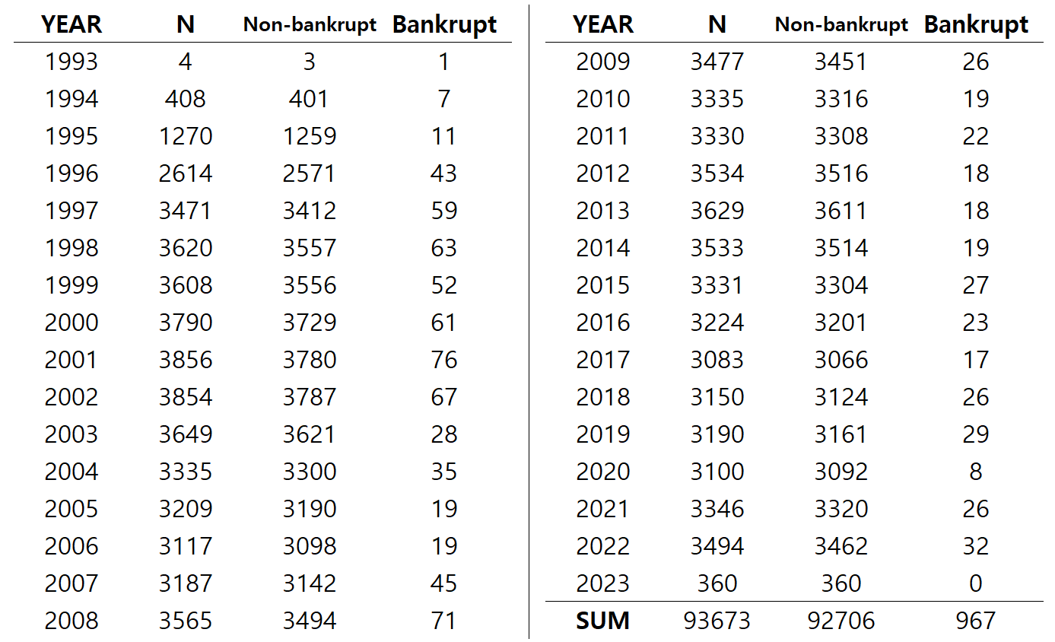
4. Data
Sample 1
We focus on sequential data(panel).
Each sample consists of 4 periods.
window size=4, step=4
Number of companies: 12,166
(CIK)
Years: 1993~2023
Default ratio: 1.032%
(967 default/93,673 total samples)
Total data points: 374,692
(93,673 samples*4 periods each)
Sample 2
Sample 3
SUM

Slide 19
Contents
1. Introduction
2. Literature Review
3. Models - BERT
4. Data
5. Synthetic Data - Gen AI (ChatGPT)
6. Result
7. Conclusion & Discussion

Slide 20
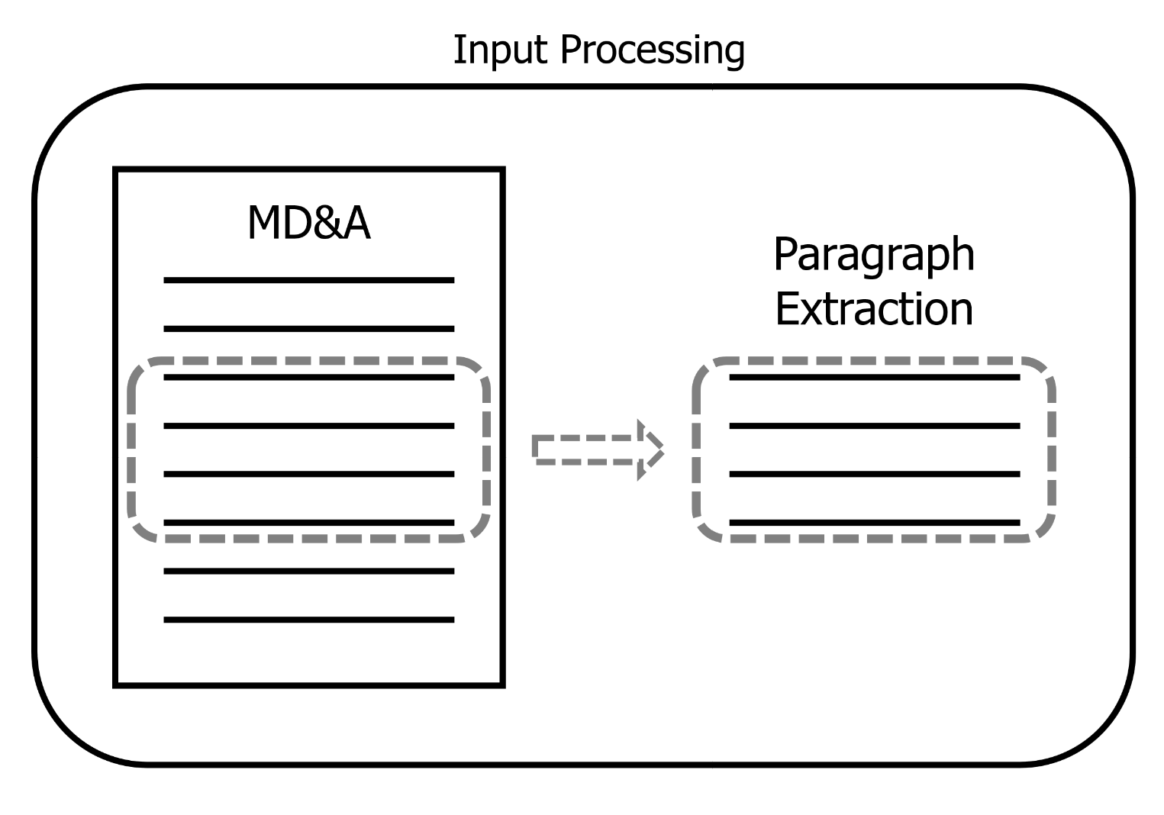
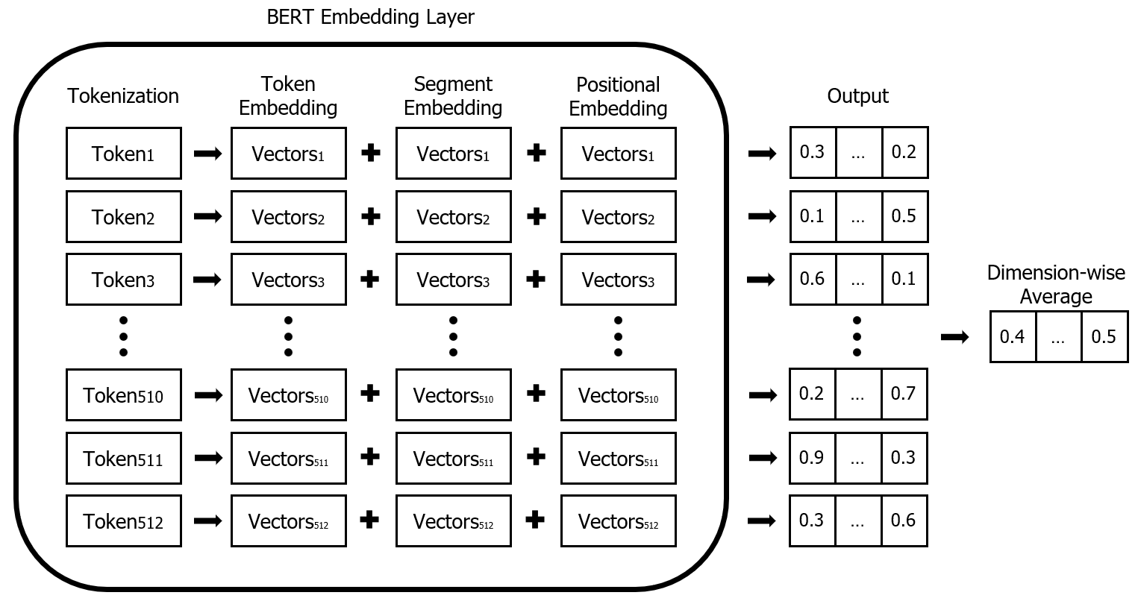
5. Methodology - Preprocessing
First, to accommodate the limited maximum token count of the BERT base model, we need to extract a portion of the MDA data.
Following Hoberg et al. (2015), we measure financial constraints by using the frequency of synonyms related to "financing" and "delay."
Therefore, we aim to extract the 3,000 characters that contain the highest frequency of relevant words, with a step size of 500 characters. (approximately to 512 tokens)
Delay list: delay* OR abandon OR eliminate…
Equity-focused list: issuing equity securities OR expects equity securities…
Debt-focused list: increased borrowings OR use line of credit OR expanded borrowings…

Slide 21
5. Methodology – Synthetic Data
The following four approaches are compared to address the issue of data imbalance:
1. ChatGPT(GPT-3.5-turbo):
ChatGPT is a transformer-based conversational AI model developed by OpenAI.
We apply method proposed by Dai et al. (2023), rephrasing the text.
2. Easy Data Augmentation (EDA):
We also augmented the data using the Easy Data Augmentation (EDA) method proposed by Wei et al. (2019).
EDA is a simple yet effective technique for data augmentation, which involves synonym replacement(sr), random word deletion(rd), insertion(ri), and swapping(rs). (sr = 0.3, rd = 0.05, ri = 0.1, rs = 0.1)
3. GPT Combined with EDA:
To introduce additional noise, we combined GPT-generated data with EDA.
Please rephrase the following paragraph
while strictly keeping the length of the text similar: {original MDA}
Change in the proportion of bankrupt data:
GPT(1) and EDA(2): 1% > 21%
(1 sample to 25 samples)
GPT+EDA(3): 1% > 44%
(1 to 25 GPT × 3 EDA)
if our products are not perceived as being effective at reducing the risk of covid transmission or if covid is determined to spread in ways other than through airborne transmission if we do not successfully anticipate market needs…
Our business may suffer if our products are not perceived as effective in reducing the risk of covid transmission or if covid spreads in other ways than through airborne transmission Failure to anticipate market needs…
cik: 1872356 fyearq: 2022 fqtr: 4

Slide 22
5. Methodology - Focal Loss
4. Focal loss function:
Traditional cross-entropy loss, widely used in tasks like default prediction. This approach may be less effective in scenarios where data imbalance and sample simplicity are significant issues.
The Focal Loss, introduced by Lin et al. (2017), addresses imbalanced classification by assigning greater weight to hard-to-classify cases while reducing the impact of easily classified ones.
This characteristic aligns closely with the challenges present in our research data.
Our goal is to investigate whether applying focal loss can effectively enhance the performance of corporate default prediction models by better handling the class imbalance.
Cross-Entropy Loss:
$CE\left(p_{t}\right) = −log⁡(p_{t})$
Focal Loss:
$FL\left(p_{t}\right) ={{−(1−p_{t})}^{γ}log\left(p_{t}\right)}$
$p_{t}$: The predicted probability for the true class label.
$γ$: The focusing parameter, where $γ$>0 reduces the relative loss for well-classified examples, allowing the model to prioritize harder examples.

Slide 23
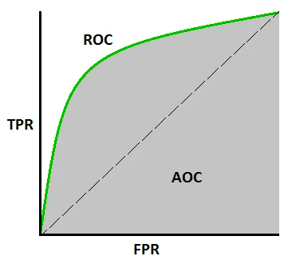
5. Methodology - Training
1. Training method:
We applied early stopping, monitoring the AUC of the validation set with a patience of 10 epochs, and restored the best weights to evaluate the results.
2. Performance measure:
We use AUC (Area Under the Curve) to measure the performance of models.
The ROC curve represents the relationship between TPR and FPR, and AUC refers to the area under this curve.
AUC allows for comparing model performance on imbalanced datasets.
The AUC ranges from 0 to 1, where 1 represents perfect classification performance, and 0.5 represents random guessing.
$$TPR\left(True Positive Rate\right)= \frac{True Positive (TP)}{True Positive\left(TP\right)+False Negatives(FN)}$$
$$FPR(False Positive Rate) = \frac{False Positive (FP)}{False Positive\left(FP\right)+True Negatives(TN)}$$

Slide 24
5. Methodology - Training
3. Multimodal model:
Through our research, we aim to validate the utility of multimodal approaches, particularly in scenarios where predicting defaults using accounting data alone proves challenging.
We hypothesize that multimodal models incorporating MDA will provide greater value in such cases.
First, during financial crises, corporate credit risk generally increases across the board.
Second, studies such as Bechworth et al. (2010), Lin et al. (2011), and Feldhutter et al. (2018) suggest that credit risk for mid-cap companies is influenced by a relatively greater number of factors, many of which exhibit highly nonlinear relationships.
In these cases, it is judged that predicting defaults is relatively difficult, and we aim to explore whether this issue can be addressed through multimodal approaches.
Before Financial Crisis: train(1993~2000), validation(2001~2003), test(2004~2006)
After Financial Crisis: train(1993~2003), validation(2004~2006), test(2007~2009)
Before Covid-19: train(1993~2014), validation(2015~2017), test(2018~2020)
After Covid-19: train(1993~2017), validation(2018~2020), test(2021~2023)

Slide 25
Contents
1. Introduction
2. Literature Review
3. Models - BERT
4. Data
5. Synthetic Data - Gen AI (ChatGPT)
6. Result
7. Conclusion & Discussion

Slide 26
6. Result
Table 1. Results from the BERT Models with Random Split (6:2:2)
First, we confirmed that defaults can be predicted using text data.
Among the three BERT models, FinBERT-tone by Yiyanghkust (2023) showed slightly superior performance compared to the others.
Using the DNN (4qtr) model, we observed that applying quarterly data to the model yields better performance than using annual data.

Slide 27
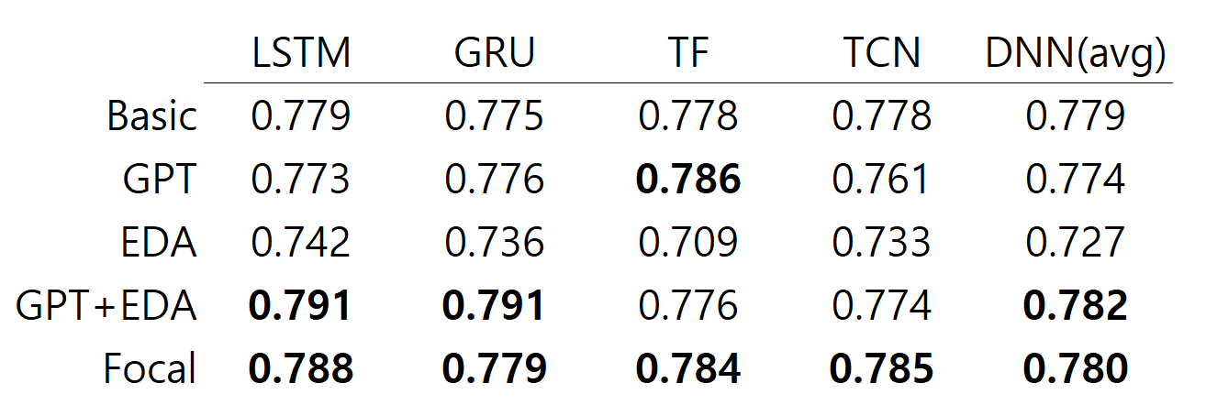
6. Result
Table 2. Results from the FinBERT(2023) with Random Split (6:2:2)
Ultimately, not all methods resulted in significant performance improvements.
We speculate that this issue arises because most existing studies on text data augmentation focus on short texts.
The GPT+EDA method, which introduced the most noise, showed some potential, but its impact was limited.
However, the application of focal loss consistently demonstrated better results across all methods, highlighting its effectiveness.

Slide 28
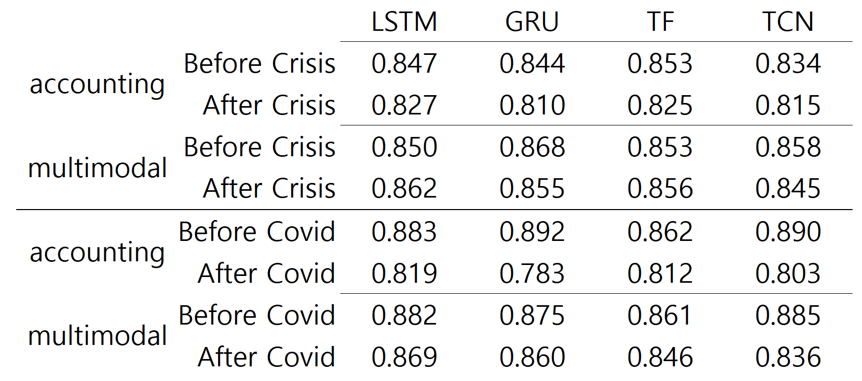
6. Result
Table 3. Results from the Accounting & Mutimodal model with year split
We observe that, for both the 2008 crisis and COVID-19, the predictive performance of the models using accounting data decreases after the crisis.
However, the improvement seen in the multimodal model is more pronounced.
This suggesting that, in situations like a crisis where the overall credit risk increases and accounting data fails to perform effectively.
Text data can be particularly useful and more effectively leveraged.

Slide 29
6. Result
Table 4. Results from the Accounting & Mutimodal model across cap-sizes
We compare all sizes with under mid-cap. To exclude the impact of the crisis, we focus on the period before COVID-19.
As seen in previous studies on mid-cap credit risk, we find that predicting defaults becomes slightly more difficult for mid-cap companies.
The performance improvement through the multimodal approach appears to be more significant for mid-cap companies.

Slide 30
Contents
1. Introduction
2. Literature Review
3. Models - BERT
4. Data
5. Synthetic Data - Gen AI (ChatGPT)
6. Result
7. Conclusion

Slide 31
7. Conclusion
This study used Fin-BERT to embed MD&A (Management Discussion and Analysis) text data to predict corporate defaults.
We confirm that a corporation’s defaults can indeed be predicted with textual information.
To address the issue of data imbalance within MD&A data, we applied data augmentation techniques using ChatGPT and a focal loss function, leading to noticeable performance improvements.
Synthetic data using ChatGPT
We showed that a multimodal model incorporating text data can effectively supplement and enhance predictions.
This trend was especially noticeable after COVID-19 and mid-cap firms
Discussions
(Longer texts) We can apply the advanced capabilities of GPT-4 or higher version to handle more complex instructions and generate better-augmented data for longer texts.
(Longer data sequence) In this study, the dataset is limited to only four sequences. We can manually collect longer data.
(Longer extraction) The basic BERT model is limited to 512 tokens. BERT-large or Longformer can be applied for a larger number of tokens for better extraction methods.

Slide 32
Reference
[1] Araci, Dogu. 2019. "FinBERT: Financial Sentiment Analysis with Pre-trained Language Models." arXiv Preprint, arXiv:1908.10063. https://arxiv.org/abs/1908.10063.
[2] Bai, Shaojie, J. Zico Kolter, and Vladlen Koltun. 2018. "An Empirical Evaluation of Generic Convolutional and Recurrent Networks for Sequence Modeling." arXiv Preprint, arXiv:1803.01271. https://arxiv.org/abs/1803.01271.
[3] Barboza, Flavio, Herbert Kimura, and Edward Altman. 2017. "Machine Learning Models and Bankruptcy Prediction." Expert Systems with Applications 83: 405-417. https://doi.org/10.1016/j.eswa.2017.04.006.
[4] Beckworth, David, Kyoung Philip Moon, and Jeremy H. Toles. 2010. "Monetary Policy and Corporate Bond Yield Spreads." Applied Economics Letters 17 (12): 1139-1144. https://doi.org/10.1080/00036840902845368.
[5] Chen, Tsung-Kang, Hsien-Hsing Liao, Geng-Dao Chen, Wei-Han Kang, and Yu-Chun Lin. 2023. "Bankruptcy Prediction Using Machine Learning Models with the Text-Based Communicative Value of Annual Reports." Expert Systems with Applications 233: 120714. https://doi.org/10.1016/j.eswa.2023.120714.
[6] Cho, Kyunghyun, Bart van Merriënboer, Dzmitry Bahdanau, and Yoshua Bengio. 2014. "On the Properties of Neural Machine Translation: Encoder-Decoder Approaches." arXiv Preprint, arXiv:1409.1259. https://arxiv.org/abs/1409.1259.
[7] Dai, Haixing, Zhengliang Liu, Wenxiong Liao, Xiaoke Huang, Yihan Cao, Zihao Wu, Lin Zhao, Shaochen Xu, Wei Liu, Ninghao Liu, Sheng Li, Dajiang Zhu, Hongmin Cai, Lichao Sun, Quanzheng Li, Dinggang Shen, Tianming Liu, and Xiang Li. 2023. "AugGPT: Leveraging ChatGPT for Text Data Augmentation." arXiv Preprint, arXiv:2302.13007. https://arxiv.org/abs/2302.13007.
[8] Devlin, Jacob, Ming-Wei Chang, Kenton Lee, and Kristina Toutanova. 2019. "BERT: Pre-training of Deep Bidirectional Transformers for Language Understanding." arXiv Preprint, arXiv:1810.04805. https://arxiv.org/abs/1810.04805.
[9] Feldhütter, Peter, and Stephen M. Schaefer. 2018. "The Myth of the Credit Spread Puzzle." The Review of Financial Studies 31 (8): 2897-2942. https://doi.org/10.1093/rfs/hhy032.
[10] Hochreiter, Sepp, and Jürgen Schmidhuber. 1997. "Long Short-Term Memory." Neural Computation 9 (8): 1735-1780. https://doi.org/10.1162/neco.1997.9.8.1735.
[11] Hoberg, Gerard, and Vojislav Maksimovic. 2015. "Redefining Financial Constraints: A Text-Based Analysis." The Review of Financial Studies 28 (5): 1312-1352. https://doi.org/10.1093/rfs/hhu089.
[12] Huang, Allen H., Huan Wang, and Yang Yang. 2023. "FinBERT: A Large Language Model for Extracting Information from Financial Text." Contemporary Accounting Research 40: 806-841. https://doi.org/10.1111/1911-3846.12832.
[13] Kim, Alex, and Sangwon Yoon. 2023. "Corporate Bankruptcy Prediction with Domain-Adapted BERT." arXiv Preprint, arXiv:2312.03194. https://arxiv.org/abs/2312.03194.
[14] Kim, Hyeongjun, Hoon Cho, and Doojin Ryu. 2021. "Corporate Bankruptcy Prediction Using Machine Learning Methodologies with a Focus on Sequential Data." Computational Economics 59: 1213-1240. https://doi.org/10.1007/s10614-021-10126-5.
[15] Korangi, Kamesh, Christophe Mues, and Cristián Bravo. 2023. "A Transformer-Based Model for Default Prediction in Mid-Cap Corporate Markets." European Journal of Operational Research 308 (1): 306-320. https://doi.org/10.1016/j.ejor.2022.10.032.
[16] Lin, Hai, Junbo Wang, and Chunchi Wu. 2011. "Liquidity Risk and Expected Corporate Bond Returns." Journal of Financial Economics 99 (3): 628-650. https://doi.org/10.1016/j.jfineco.2010.10.004.
[17] Mai, Feng, Shaonan Tian, Chihoon Lee, and Ling Ma. 2019. "Deep Learning Models for Bankruptcy Prediction Using Textual Disclosures." European Journal of Operational Research 274 (2): 743-758. https://doi.org/10.1016/j.ejor.2018.10.024.
[18] Vaswani, Ashish, Noam Shazeer, Niki Parmar, Jakob Uszkoreit, Llion Jones, Aidan N. Gomez, Łukasz Kaiser, and Illia Polosukhin. 2017. "Attention Is All You Need." Advances in Neural Information Processing Systems (NeurIPS) 30: 5998-6008. https://arxiv.org/abs/1706.03762.
[19] Veganzones, David, and Eric Séverin. 2018. "An Investigation of Bankruptcy Prediction in Imbalanced Datasets." Decision Support Systems 112: 111-124. https://doi.org/10.1016/j.dss.2018.06.011.
[20] Wei, Jason, and Kai Zou. 2019. "EDA: Easy Data Augmentation Techniques for Boosting Performance on Text Classification Tasks." arXiv Preprint, arXiv:1901.11196. https://arxiv.org/abs/1901.11196.
[21] Lin, Tsung-Yi, Priya Goyal, Ross Girshick, Kaiming He, and Piotr Dollár. 2017. "Focal Loss for Dense Object Detection." Proceedings of the IEEE International Conference on Computer Vision (ICCV): 2980-2988. https://doi.org/10.1109/ICCV.2017.324.

Slide 33
Thank you.

