Slide 1


November 29, 2024
Digital trade and financial development
in European transition economies
Hyun-Jung Nam
Doojin Ryu

Slide 2
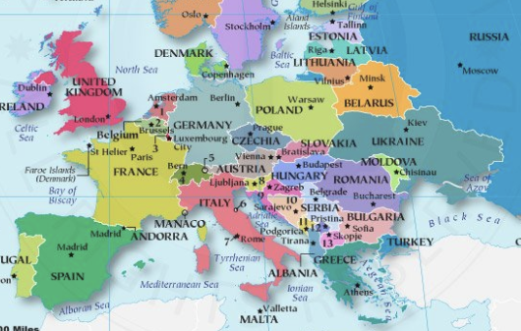
Figure 1. Map of European transition economies
European transition economies

Slide 3
Figure 2. Trends of digital trade in transition economies
European transition economies
Notes. This figure illustrates trends of digital trade in transition economies for the period 2002 to 2021. The x-axis denotes the year, and the y-axis denotes ICT services exports, measured as the ratio of ICT services exports to services exports. Source: https://data.imf.org.

Slide 4
Figure 3. Trends of financial development across regions
European transition economies
Notes. This figure illustrates financial development across regions from 2002 to 2021. The x-axis denotes the year, and the y-axis denotes financial development measured as the financial development index. The dark red, yellow, green, grey, red, and sky-blue lines represent the financial development index in advanced markets, European regions, ASEAN regions, all countries, European transition economies, and Africa, respectively. Source: https://data.imf.org.

Slide 5
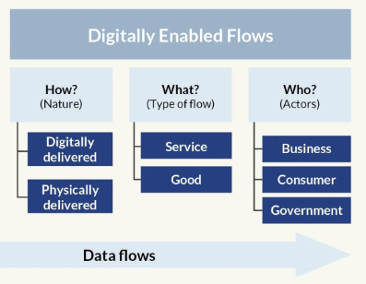
Figure 4. Digital trade and financial development
European transition economies
Financial Development

Slide 6

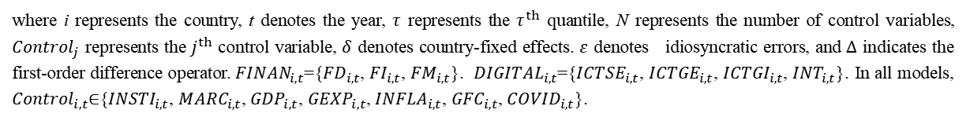
FE regression model:
${FINAN}_{i,t}=α_{0}+β_{0}{DIGITAL}_{i,t}+α_{0}{{DIGITAK}^{2}}_{i,t}+\sum_{j=1}^{N}{γ_{j}}{Control}_{j,i,t}+δ_{i}+ε_{i,t}$, (1)
MMQR model:
${FINAN}_{i,t}=α_{0}(τ)+β_{0}{(τ)DIGITAL}_{i,t}+β_{1}(τ){{DIGITAL}^{2}}_{i,t}+\sum_{j=1}^{N}{γ_{j}}(τ){Control}_{j,i,t}+ε_{i,t}$, (2)
Methodology
European transition economies
where i represents the country, t denotes the year, $τ$ represents the $τ^{th}$ quantile, N represents the number of control variables, ${Control}_{j}$ represents the $j^{th}$ control variable, $δ$ denotes country-fixed effects. $ε$ denotes idiosyncratic errors, and $∆$ indicates the first-order difference operator. ${FINAN}_{i,t}$={${FD}_{i,t}$, ${FI}_{i,t}$, ${FM}_{i,t}$}. ${DIGITAL}_{i,t}$={${ICTSE}_{i,t}$, ${ICTGE}_{i,t}$, ${ICTGI}_{i,t}$, ${INT}_{i,t}$}. In all models, ${Control}_{i,t}$∈{${INSTI}_{i,t}$, ${MARC}_{i,t}$, ${GDP}_{i,t}$, ${GEXP}_{i,t}$, ${INFLA}_{i,t}$, ${GFC}_{i,t}$, ${COVID}_{i,t}$}.

Slide 7
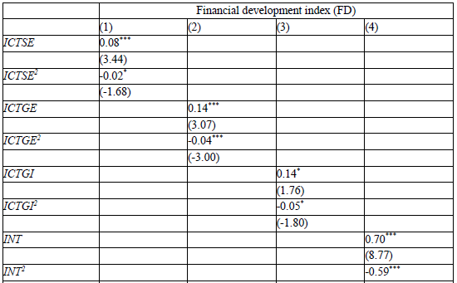
Table 1. Impacts of digital trade on financial development: FE model
European transition economies
Notes. This table presents the effects of digital trade, including ICT services export (ICTSE) in M1, ICT goods export (ICTGE) in M2, ICT goods import (ICTGI) in M3, and internet penetration (INT) in M4 on financial development using fixed effect (FE) regression. The financial development index (FD) is a dependent variable in all the models. ICTSE is measured as the ratio of the ICT service exports to service exports. ICTGE is measured as the ratio of the ICT goods exports to total goods exports. ICTGI is measured as the ratio of the ICT goods imports to the total goods imports. INT is the proxy for internet penetration, measured as the ratio of the number of Internet users to the population. The control variables are INSTI, MARC, GDP, GEXP, INFLA, GFC, and COVID.

Slide 8

Digital trade for the peak points of financial development
To determine the peak points of financial development, we estimate digital trade.
$\left(\frac{∂\tilde{FINAN}}{∂L.DIGITAL}\right)=β_{0}+2β_{1}{DIGITAL}_{i,t}$.
We estimate ICTSE, ICTGE, and ICTGI to determine the peak points of financial development:
  ICTSE: 28%, ICTGE: 16%, and ICTGI: 13%.
  As of 2021, ICT services exports, ICT goods exports, and ICT goods imports account for approximately 18.6%, 4.5%, and 7.0%, respectively.
European transition economies

Slide 9
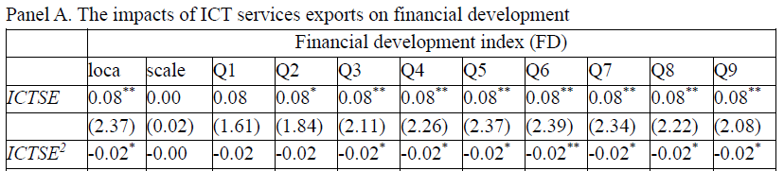
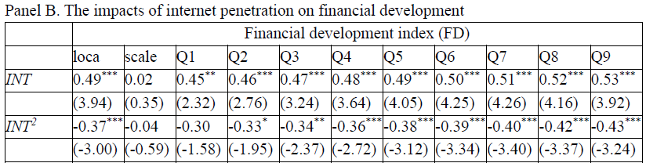
Table 2. Impacts of digital trade on financial development: MMQR model
European transition economies
Notes. This table presents the effects of digital trade, such as services export (ICTSE) in Panel A and internet penetration (INT) in Panel B, on financial development using MMQR. Columns Q1 to Q9 show the results for the 10% to 90% quantiles. Location refers to central tendency estimates derived via least squares, while Scale indicates variability measures based on the spread of the dependent variable. The dependent variable is the financial development index in both Panel A and Panel B. ICTSE is measured as the ratio of the ICT service exports to service exports. INT is the proxy for internet penetration, measured as the ratio of the number of Internet users to the population. The control variables are INSTI, MARC, GDP, GEXP, INFLA, GFC, and COVID. Obs. is the number of country-year observations. The numbers in parentheses are t-statistics. Statistical significance at the 1%, 5%, and 10% levels is indicated by ***, **, and *, respectively.

Slide 10
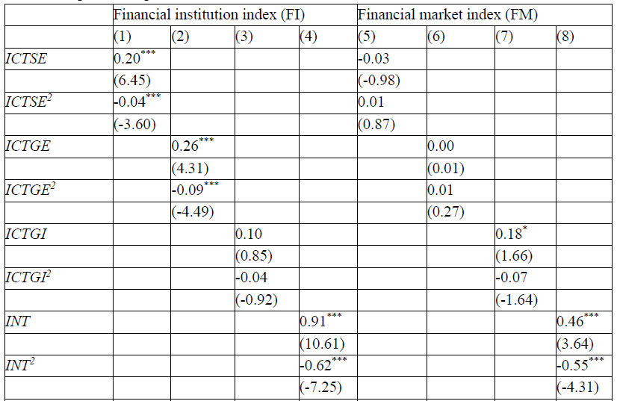
Table 3. Impacts of digital trade on financial institutions and markets: FE model
European transition economies
Notes. This table presents the effects of digital trade, including ICT services export (ICTSE), ICT goods export (ICTGE), ICT goods import (ICTGI), and internet penetration (INT) on financial institutions (FI) in models (1) to (4) and financial markets (FM) in models (5) to (8) using fixed effect (FE) regression. The dependent variable FI, measured as the financial institution index, in models (1) to (4) and FM, measured as the financial market index, in models (5) to (8).

Slide 11
A significant quadratic relationship between digital trade and financial development.
  At lower levels, digital trade fosters financial development; however, as digital trade intensifies, its benefits diminish and can even become detrimental.
  The initial positive impact of digital trade on financial markets and institutions aligns with various theoretical foundations, highlighting key benefits such as increased foreign investment, broader access to financial services, and enhanced efficiency in financial transactions.
  However, at more advanced levels of digital trade, negative effects emerge, primarily due to increased reliance on foreign capital, currency volatility, and strain on financial systems.
  As ICT service exports grow, firms become increasingly dependent on foreign capital, which exposes them to exchange rate fluctuations and heightens economic vulnerability to currency volatility
Key contribution 1
European transition economies

Slide 12
One of our key contributions is identifying the peak levels of digital trade—points at which its impact on financial development is maximized—to assess whether digital trade should be expanded in the current context.
Our findings reveal a critical insight: transition economies remain significantly below the peak levels of digital trade required to fully drive financial development.
  Digital trade represents a burgeoning industry in these economies, yet its current levels are insufficient to realize its full potential for driving financial growth.
  Expanding digital trade to reach its peak levels is not just an opportunity but a strategic priority for maximizing its contribution to financial development.
  By identifying these gaps and emphasizing the importance of targeted strategies, we highlight the pivotal role digital trade can play in accelerating the financial development of transition economies.
Key contribution 2
European transition economies

Slide 13
While digital trade demonstrates a significant inverted U-shaped relationship with financial institutions, its impact on financial markets is notably limited.
  The financial market index in these economies is considerably lower than the financial institution index.
  Capital markets, such as stock and bond markets, are either non-existent or remain in their infancy.
In many countries, including Albania, Belarus, Bosnia and Herzegovina, Bulgaria, Estonia, Latvia, Lithuania, Moldova, North Macedonia, Romania, Serbia, Slovenia, and Ukraine, financial market index values are close to zero.
  This significantly limits the depth and diversity of financial markets. Many transition economies rely heavily on “bank-centered financial systems”, where bank-based lending dominates over capital market financing including stocks and bonds
Strong legal and institutional frameworks are essential for supporting capital market development and enabling financial markets to function effectively.
Key contribution 3
European transition economies

Slide 14
Thank You

