Slide 1
The Optimal Capital Structure in Venture Firms: Theory and Evidence
Sunghwan Kim (Kyungpook National University)

Slide 2
1
Introduction
Traditional financial management theories often describe the relationship between financial structure and cost of capital as U-shaped (Modigliani and Miller, 1963; Myers, 1984).
However, in certain ranges, particularly in the context of early-stage ventures, heightened competition, or high-risk environments characterized by technological innovation and uncertainty, the relationship can take an inverted U-shape (Stiglitz and Weiss, 1981; Diamond, 1984).
Structurally, high-risk venture firms in such environments tend to exhibit an inverted U-shaped relationship between leverage and borrowing costs.

Slide 3
1
Introduction
This study aims to theoretically explain this phenomenon and provide empirical evidence to support it. By analyzing the financial behavior and outcomes of high-risk venture firms, this research seeks to contribute to the understanding of how borrowing and financial strategies can be optimized under conditions of uncertainty and risk.
This study aims to theoretically explain this phenomenon and provide empirical evidence to support it.
By analyzing the financial behavior and outcomes of high-risk venture firms, this research seeks to contribute to the understanding of how borrowing and financial strategies can be optimized under conditions of uncertainty and risk.

Slide 4
2
Literature Review
The M&M theory (Modigliani and Miller, 1958) begins with the premise that capital structure does not affect firm value.
Their revised theory (1963), however, incorporates tax benefits, suggesting that debt usage can positively impact firm value.
This revised theory evolved into the trade-off theory (TOT), which balances bankruptcy costs and tax-saving benefits to identify an optimal capital structure aimed at maximizing firm value.
Furthermore, bankruptcy cost theory and agency cost theory have been pivotal in advancing the understanding of optimal capital structure decisions, becoming central to financial management research.
Characteristics

Slide 5
2
Literature Review
The M&M theory (Modigliani and Miller, 1958) begins with the premise that capital structure does not affect firm value.
Their revised theory (1963), however, incorporates tax benefits, suggesting that debt usage can positively impact firm value.
This revised theory evolved into the trade-off theory (TOT), which balances bankruptcy costs and tax-saving benefits to identify an optimal capital structure aimed at maximizing firm value.
Furthermore, bankruptcy cost theory and agency cost theory have been pivotal in advancing the understanding of optimal capital structure decisions, becoming central to financial management research.
Characteristics

Slide 6
2
Literature Review
Market reactions to corporate financing decisions are also far from straightforward. For example, while investors and shareholders often favor the accumulation of retained earnings, concerns about heightened bankruptcy risks and inefficient capital allocation can create conflicting perspectives.
Consequently, market responses based on pecking order theory or signaling theory can be either positive or negative (Myers, 1984; Li and Islam, 2019).
When synthesizing prior studies on financial structure and cost of capital, it becomes evident that no single theory comprehensively explains their relationships. Instead, various financial theories highlight the endogenous interactions between multiple financial variables.
Optimal capital structure exists where the firm value is maximized and the cost of capital is minimized. The D/E ratio will have a U-shaped effect on the cost of capital.
Characteristics

Slide 7
2
Literature Review: Questions and Solutions
The U-shaped relationship exists when?
Why don’t see the relationship in reality? When we do? When we don’t?
Harris and Raviv (1991) highlight the close relationship between financial ratios, cash flow, and capital structure, asserting that these factors act as endogenous elements of a firm’s long-term financial strategy.
Endogenous factor’s effects in capital financing
- Whose decisions: the firm, the bank or the market?
- We need a new theory to synthesize the prior studies to solve the puzzle.
We need a new theory!
Characteristics

Slide 8
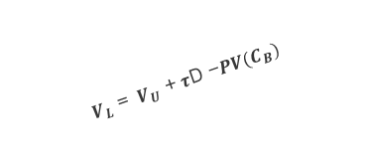
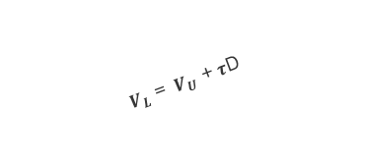
3
Ⅲ. Model
Introduction to a New Capital Structure Model
Debt, Capital Structure and Default Risks
Firm Value and Cost of Debt
Firm Value with tax saving effect
${ V}_{L}$ = ${ V}_{U}$ + $τ$D
Default risk reflected
${ V}_{L}$ = ${ V}_{U}$ + $τ$D -$PV(C_{B})$
$${ V}_{U}$$
Tax saving effect
No debt firm value
PV(Default risk)
Capital structure (D/E$)$

Slide 9
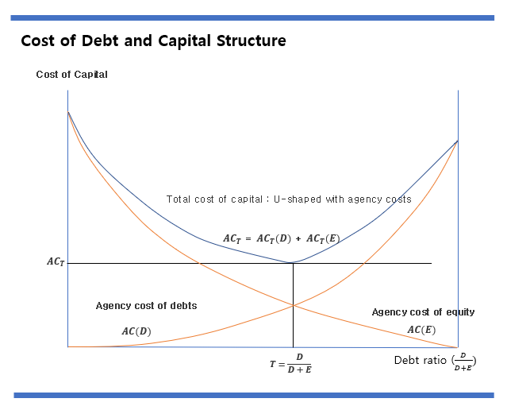
3
Ⅲ. Model
As D/E ratio increases the Cost of Debt (COD) increases while the Cost of Equity (COE) decreases in Agency theory.
Trade off Theory (TOT) between COD and COE
(Jensen and Meckling, 1976; Harris and Raviv, 1991).
=> The goal is to minimize the Weighted Average Cost of Capital (WACC) at the optimal level.

Slide 10
3
Ⅲ. Model
As D/E ratio increases, COD and COE in tandem increases.
because higher leverage increases the risk of financial distress,
leading creditors to demand a higher risk premium.
(Diamond, 1984; Stiglitz and Weiss, 1981).
No optimal capital structure; The lower D/E, the better.

Slide 11
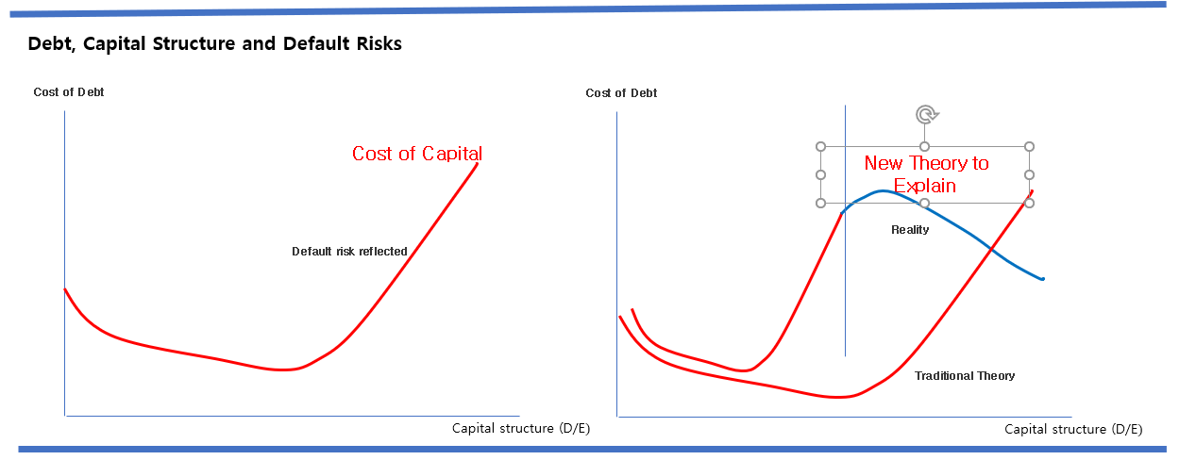
3
Ⅲ. Model
Introduction to a New Capital Structure Model : mathematical ?
As D/E ratio increases the Cost of Debt (COD) declines, increases and then decreases in the market (Proposition I) : Inverse N-shaped
Two two critical points: One the lowest Cost, the other the highest cost
(Proposition II) : Higher-order polynomial Relationship Model

Slide 12
3
Ⅲ. Model
Introduction to a New Capital Structure Model : mathematical ?
- Baseline Model based on
Model for lower level of D/E (capital structure for low risk firms)
= The> banks are rational; U-shaped to be proved.
Traditional Theory of TOT ((trade off theory) (Modigliani and Miller,
1963; Myers, 1984) and
POT (pecking order theory) by (Myers and Majluf, 1984)
Model Suggestion: Game Approach (Mono- & Duo- polistic Model)
=> Two Banks competition => to some level, both banks benefits
from the lower risk at the whole market level by sharing/copying
the same and with different strategies
=> higher efficiency and from the revenues from lending
in TOT resulting from the portfolio effect model by Eung Han Kim

Slide 13
3
Ⅲ. Model
Introduction to a New Capital Structure Model?
- Extended Model for Reverse TOT and POT based on
With extreme uncertainty (capital structure for high risk firms)
=> The banks takes strategic positions to maximize their own benefits.
=> Firms at risk may hurt the banks and the market.
Model Suggestion: Game Approach (Mono- & Duo- polistic Model)
=> Two Banks competition => beyond some level, both banks benefits
by further lowering risk premium at the whole market
=> New Nash Eqm for Lenders and Borrowers (Firms)
1) Reverse TOT: They are better off with lower cost of capital with extended
debt financing, or higher D/E ratios of firms with high uncertainty
2) Reverse POT: Equity Financing=>Debt Financing => Internal Financing

Slide 14
4
IV. Empirical Analysis
1. Empirical Model
$${Debt Cost}_{it}​$$
$$=β_{0}​+β_{1}{​Leverage​}_{it}+β_{2}​{Leverage}_{it}^{2}+β_{3}​{Leverage}_{it}^{3}​ + β_{4\sim }\sum_{j=4}^{18}{{Controls}_{it}}​+μ_{i}+λ_{t}​+ε_{it}​$$
${COE}_{it}​$ = E($R_{it})$
$$=β_{0}​+β_{1}β_{1}{​Leverage​}_{it}+β_{2}​{Leverage}_{it}^{2}+β_{3}​{Leverage}_{it}^{3}​ + β_{4\sim }\sum_{j=4}^{18}{{Controls}_{it}}​+μ_{i}+λ_{t}​+ε_{it}​$$
$${WACC}_{it} =β_{0}​+β_{1}{​Leverage​}_{it}+β_{2}​{Leverage}_{it}^{2}+β_{3}​{Leverage}_{it}^{3}​ + β_{4\sim }\sum_{j=4}^{18}{{Controls}_{it}}​+μ_{i}+λ_{t}​+ε_{it}$$

Slide 15
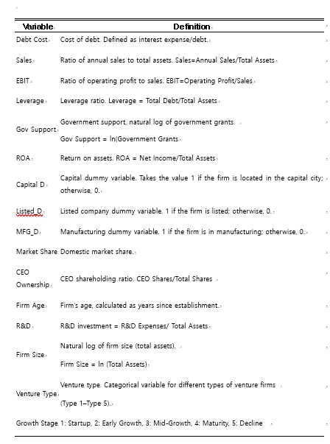
4
IV. Empirical Analysis
2. Variables to Use (Partially Introduced)

Slide 16
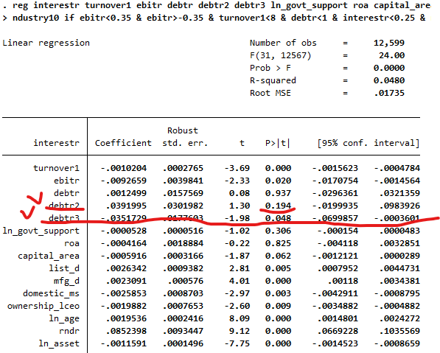
4
IV. Empirical Analysis
3. Empirical Analysis: Inverse N-shaped Relationship
As D/E ratio increases the Cost of Debt (COD) declines, increases and then decreases in the market (Proposition I) : Inverse N-shaped
Two two critical points: One the lowest Cost, the other the highest cost
(Proposition II) : Higher-order polynomial Relationship Model

Slide 17
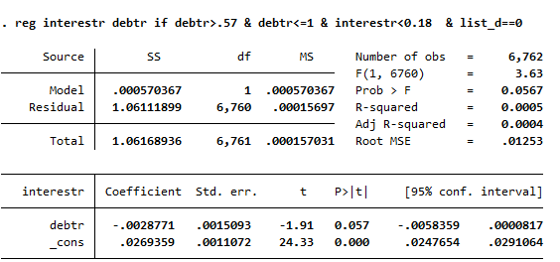
4
IV. Empirical Analysis
4. Empirical Analysis : At High D/E => The higher D/E ratio, the lower COD
Traditional U-shaped => Inverse U-shaped or inverse N-shaped in reality
Lower COD for highly indebted firms
=> Traditional TOT, POT may not reflect actual financing in the market.

Slide 18
5
V. Conclusion
Banks are rational in lending to low-risk firms, as these firms have a lower probability of default.
Rational lending practices align with the TOT's framework, as banks consider both the firm's creditworthiness and the cost of financial distress.
Traditional financial theories, such as the Trade-Off Theory (TOT) and Pecking Order Theory (POT), often describe the relationship between capital structure and cost of capital as U-shaped.
In reality, the relationship between leverage and the cost of capital often exhibits inverse U-shaped or inverse N-shaped patterns, particularly for highly indebted firms. For these firms.
The new theory can explain better all those prior Trade-Off Theory (TOT) and Pecking Order Theory (POT) up to some level, and those reverse TOT and POT beyond other level, at the same time with game theoretical approach introduced.

Slide 19
Thank You~

