Slide 1
Liability-Driven Investment under Inflation Risk
2024.11.29.
Hyeontae Jo
POSTECH IME
Joint Work with Myung Jun Kim and Bong-Gyu Jang

Slide 2
1
Introduction

Slide 3
Liability-Driven Investment (LDI)
1. Introduction
Liability-driven investment gets important
In the dynamic and rapidly evolving world of international finance
To manage a portfolio that meets the liabilities of an investor, while also mitigating various economic risks
LDI strategies have diverged from conventional portfolio management paradigms, prioritizing the management of liability risks
Conceptual framework of LDI
Meeting financial liabilities by precisely managing assets
Aligning them with the temporal and financial horizons of the liabilities

Slide 4
Inflation Risk
1. Introduction
Traditionally, LDI have been adopted for pension funds and insurance, which have long maturity
Inflation plays significant role
COVID-19 pandemic has further intensified the challenges and risks faced by the investment sector, particularly through its impact on inflation
Steady rise in the overall price level of goods and services erodes purchasing power and distorts expected investment returns
It is crucial to adopt strategic measures to navigate these uncertain economic conditions and safeguard the feasibility of LDI strategies

Slide 5
Research Goals
1. Introduction
This study…
Presents a comprehensive analysis of practical approaches that combine liability management with strategic inflation hedging
Offers a detailed examination of LDI in the context of inflation risk, incorporating analytical models and theoretical foundations
Demonstrates a reliable investment strategy of pension fund managers to mitigate the impact of inflation risk on their portfolio
To unravel the complexity of LDI strategies in light of inflation risks

Slide 6
History (1/2)
1. Introduction
1. Restrictions in Portfolio Selection Problems
Grossman and Zhou (1996)
Optimal portfolio selection problem under the constraint of terminal wealth
Showed restriction can affect both the optimal wealth level and asset allocation
Basak and Shapiro (2001)
Dynamic portfolio selection problems in the presence of both Value-at-Risk(VaR) constraints
Found that VaR might lead to a larger exposure to risky assets
2. LDI
Sharpe and Tint (1990)
Emphasized the need to simultaneously consider liabilities and wealth, utilizing a mean-variance portfolio model with liability asset ratios
Detemple and Rindisbacher (2008)
Introduced a dynamic model with respect to the funding ratio, the ratio between the fund’s assets and liabilities
Found the optimal investment strategies in the presence of a shortfall constraint
Ang et al. (2012)
Addressed the mean-variance portfolio optimization problem with utility function constraints, treating it as a European put option
But did not consider the dynamically-readjusted portfolio

Slide 7
History (2/2)
1. Introduction
3. Inflation Risk
Fischer (1975)
Analyzed the demand for inflation-linked index bonds by solving households’ optimization problems, taking inflation risk into account
Highlighted the significance of such indexed bonds and explained the rationale for introducing an inflation-linked index bond market
Brennan and Xia (2002)
Tackled a dynamic asset allocation issue that included stochastic interest rates and indexed bonds
Demonstrated the importance of inflation-linked index bonds for conservative and long-term investments

Slide 8
2
Financial Market

Slide 9
Inflation Process and Inflation-linked Index Bond
2. Financial Market
($n+2$) assets: $n$ risky assets (stocks),$1$ Inflation-linked index bond(IIB),
and $1$risk-free asset
Price level of the inflation rate $I_{t}$
$\frac{dI_{t}}{I_{t}}=μ_{I}dt+σ_{I}dW_{I,t}$
$μ_{I}$is the instantaneous expected inflation rate, and $σ_{I}$ is its volatility
Inflation-linked Index Bond $P_{t}$
$\frac{dP_{t}}{P_{t}}=Rdt+$ $\frac{dI_{t}}{I_{t}}=(R+μ_{I})dt+σ_{I}dW_{I,t}$
$R$ is the real interest rate
We assume that the IIB has exactly the same risk source with the inflation risk

Slide 10
Asset Price Processes
2. Financial Market
Inflation-independent Risky and Risk-free Asset Processes
$i$-th Risky Assets (Stocks) $S_{i,t}$
$\frac{dS_{i,t}}{S_{i,t}}=μ_{i}dt+σ_{i}dW_{i,t}$
$μ_{i}≥r$is the expected rate of return for stock $i$, and $σ_{i}$ is their volatility
Correlation structure: $d\left\langle W_{i,t},W_{j,t}\right\rangle =ρ_{i,j}dt \text{for} i,j∈\{1,2,⋯,n\} \text{and} i≠j$
Risk-free Asset $B_{t}$
$\frac{dB_{t}}{B_{t}}=rdt$
$r$ is the instantaneous nominal risk-free rate

Slide 11
3
Model

Slide 12
Fund Manager’s Problem (1/3)
3. Model
Let $π_{i,t}$ and $π_{I,t}$denote the proportion of assets held in stock $i$ and IIB, respectively.
From this, the fund manager’s wealth $X_{t}$ is described
$$\frac{dX_{t}}{X_{t}}=\sum_{i=1}^{n}{π_{i,t}\frac{dS_{i,t}}{S_{i,t}}+}π_{I,t}\frac{dP_{t}}{P_{t}}+\left(1−\sum_{i=1}^{n}{π_{i,t}−π_{I,t}}\right)\frac{dB_{t}}{B_{t}}$$
We assume the fund manager’s liability is deterministic over time.
The assumption does not fully reflect the stochastic nature of changing liability characteristics, but the determined liability value can be considered as the expected value of future liability.
Some studies (Sharpe and Tint(1990) and Ang et al. (2012), etc.) were limited by their inability to solve the portfolio choice problem analytically in a continuous time.
Our model has strengths in this regard.
Exploit an integrable function $f(t)$ to express the liability $L_{t}$ is expressed by
$dL_{t}=f\left(t\right)dt,L_{o}=l_{0},l_{0}+\int_{0}^{t}{f\left(s\right)ds}>0 for all t.$ … (1)

Slide 13
Fund Manager’s Problem (2/3)
3. Model
Funding Ratio $F_{t}$ can be defined as the ratio between the fund manager’s total wealth and liability:
$F_{t}=\frac{X_{t}}{L_{t}}$ , $\frac{dF_{t}}{F_{t}}=\left(\sum_{i=1}^{n}{π_{i,t}\left(μ_{i}−r\right)}+π_{I,t}\left(μ_{I}+R−r\right)+r−\frac{f\left(t\right)}{l_{0}+\int_{0}^{t}{f\left(s\right)ds}}\right)dt$
$+\sum_{i=1}^{n}{σ_{i}}π_{i,t}dW_{i,t}+σ_{I}π_{I,t}dW_{i,t}$ … (2)
In the context of pension funds, it is reasonable to impose some constraints on the funding ratio to mitigate this risk.
Ang et al. (2012) also demonstrates the feasibility of controlling liability by limiting the funding ratio, as evidenced by several countries implementing systematic funding ratio restrictions.
If the funding ratio is low, there is a shortage of assets compared to liabilities, indicating a potential risk in asset and liability management (ALM) for the fund manager.
On the other hand, a high funding ratio implies a huge wealth compared to liabilities, and it is reasonable that investments are made in the direction of maximizing the fund manager’s utility.

Slide 14
Fund Manager’s Problem (3/3)
3. Model
The objective: To maximize the expected utility of the funding ratio
Assume the fund manager has a utility preference of constant relative risk aversion (CRRA) type
Can be stated as following value function $V$ by controlling her investment strategy $Π_{t}= {\left(π_{1,t}, π_{2,t}, ⋯, π_{n,t},π_{I,t}\right)}^{⊺}$:
$$V\left(t,x\right)=\max_{Π_{t}}{E_{t}\left[\frac{F_{T}^{1−γ}}{1−γ} | X_{t}=x\right]}$$
For investment horizon $T ∈\left(0, ∞\right)$, the current time $0 < t< T$, and current wealth $x$.
$γ\left(γ> 0, γ≠1\right)$ is the coefficient of relative risk aversion, $E_{t}\left[ ⋅ \right]$ is the conditional expectation at time $t$ under $ℙ$-measure.
Impose a value-at-risk (VaR) constraint on the funding ratio: for $k ≥0$ and $0 < α≤1$,
$ℙ\left(F_{T}>k\right)≥1−α$ … (3)

Slide 15
Benchmark Case: Absence of VaR Constraints
3. Model
Examine the case without the VaR constraint (the “Benchmark” case)
Without VaR constraint, Bellman equation is simply
$$0=\max_{Π_{t}}\left[\frac{∂ V}{∂ t}+\left(r+\sum_{i=1}^{n}{π_{i,t}\left(μ_{i}−r\right)}+π_{I,t} \left(μ_{I}+R−r\right) −\frac{f\left(t\right)}{l_{0}+\int_{0}^{t}{f\left(s\right)ds}} \right)F_{t}\frac{∂ V}{∂ F}+\frac{1}{2}\frac{∂^{2} V}{∂ F^{2}}Π_{t}^{⊺}ΣΠ_{t}F^{2}\right]$$
where $V\left(T,x\right)=\frac{{\left(x/L_{T}\right)}^{1−γ}}{1−γ} for$ $Σ={\left(σ_{i,j}\right)}_{i,j∈\{1,2,⋯,n,n+1\}}$ denotes the covariance matrix of $n$ stocks and IID($=n+1$).
The first-order condition reveals the optimal proportion $Π^{∗}$as
$$Π_{t}^{∗}=−\frac{Σ^{−1}\left(μ−r1_{n+1}\right)\left(∂V/∂F\right)}{F_{t}\left(∂^{2}V/∂F^{2}\right)}$$
where $μ= {\left( {μ_{1}, μ}_{2}, ⋯, μ_{n},μ_{I}\right)}^{⊺}∈ℝ^{(n+1)×1}$, $1_{n+1}= {\left( 1, 1, ⋯, 1\right)}^{⊺}∈ℝ^{(n+1)×1}$.

Slide 16
Benchmark Case: Absence of VaR Constraints
3. Model
The value function can be expressed through a deterministic function $h$ with $h(T) = 1$, according to Merton (1969, 1971) and Kraft and Steffensen (2013):
$$V\left(t,F_{t}\right)=h\left(t\right)\frac{F_{t}^{1−γ}}{1−γ}$$
The optimal proportion can be rewritten as $Π_{t}^{∗}=\frac{Σ^{−1}\left(μ−r1_{n+1}\right)}{γ}$… (4)
The funding ratio evolution equation in (2) becomes
$dF_{t}=\left(r+\frac{θ^{⊺}θ}{γ}−\frac{f\left(t\right)}{l_{0}+\int_{0}^{t}{f\left(s\right)ds}}\right)F_{t}dt+\frac{φ^{⊺}}{γ}F_{t}dW_{t},F_{0}=f_{0}>0$ … (5)
where $θ=Σ^{−1/2}\left(μ−r1_{n+1}\right),φ=Γ^{⊺}Σ^{−1}\left(μ−r1_{n+1}\right)={\left(φ_{1},…,φ_{n+1}\right)}^{⊺},W_{t}={\left(W_{1,t},…,W_{n,t},W_{I,t}\right)}^{⊺}$.
Here, $Γ∈ℝ^{(n+1)×(n+1)}$ denotes the diagonal matrix with its $(i,i)$-th element $Γ_{i,i}=σ_{i}$ for $i ∈\left\{1,2, ⋯, n\right\}$ and $Γ_{n+1,n+1}=σ_{I}$.

Slide 17
The Case in the Presence of the VaR Constraint: Market Rebuilding
3. Model
Option-based Approach
Employed by Kraft and Steffensen (2013).
Unconstrained optimal funding ratio process, $Y_{t}$, in the absence of a constraint is defined as (5).
Combined with the option to represent the optimal terminal wealth in the case of a constraint.
Market Rebuilding
To apply option approach, the correlation between assets poses a significant challenge.
By defining a new Brownian motion $\tilde{W_{t}}$ to eliminate the correlations among the risky assets, we rebuild the financial market into the market with the following ($n+1)$ mutually independent assets, $A_{i,t}\left(i ∈\left\{1,2, ⋯, n+1\right\}\right)$.
$$\left\{\begin{aligned}\frac{dA_{i,t}}{A_{i,t}}=\tilde{μ_{i}}dt+\tilde{σ_{i}}d\tilde{W_{i,t}}, \\ d\left\langle \tilde{W_{i,t}},\tilde{W_{i,t}}\right\rangle =dt \text{for} i∈\{1,2,⋯,n+1\}, \\ d\left\langle \tilde{W_{i,t}},\tilde{W_{j,t}}\right\rangle =0 \text{for} i,j∈\{1,2,⋯,n+1\},i≠j. \end{aligned}\right.$$

Slide 18
The Case in the Presence of the VaR Constraint: Underlying
3. Model
$Y_{t}$ can be written as
$dY_{t}=\left(r+\frac{{\tilde{θ}}^{⊺}\tilde{θ}}{γ}−\frac{f\left(t\right)}{l_{0}+\int_{0}^{t}{f\left(s\right)ds}}\right)Y_{t}dt+\frac{{\tilde{θ}}^{⊺}}{γ}Y_{t}d\tilde{W_{t}}, Y_{0}=y_{0}>0$ … (6)
where $\tilde{θ}={\tilde{Σ}}^{−1/2}\left(\tilde{μ}−r1_{n+1}\right),\tilde{μ}={\left({\tilde{μ}}_{1},…,{\tilde{μ}}_{n+1}\right)}^{⊺},{\tilde{W}}_{t}={\left({\tilde{W}}_{1,t},…,{\tilde{W}}_{n+1,t}\right)}^{⊺}$.
Here, $\tilde{Σ}∈ℝ^{(n+1)×(n+1)}$ denotes the diagonal covariance matrix with its $(i,i)$-th element ${\tilde{Σ}}_{i,i}={\tilde{σ}}_{i,i}$ for $i ∈\left\{1,2, ⋯, n+1\right\}$
The evolution equation of $Y_{t}$ can be
$dY_{t}=\left(r+γσ_{Y}^{2}−\frac{f\left(t\right)}{l_{0}+\int_{0}^{t}{f\left(s\right)ds}}\right)Y_{t}dt+σ_{Y}Y_{t}dZ_{t}$ … (7)
Express the $Y_{t}$ with ${\tilde{Z}}_{t}$, which is a Brownian motion under the liability-adjusted risk-neutral measure, $ℚ$:
$$dY_{t}=\left(r−\frac{f\left(t\right)}{l_{0}+\int_{0}^{t}{f\left(s\right)ds}}\right)Y_{t}dt+σ_{Y}Y_{t}\tilde{Z_{t}}$$

Slide 19
The Case in the Presence of the VaR Constraint: KS’ Idea
3. Model
If the terminal funding ratio is below $k$
The fund manager must prepare for the potential downside risk by purchasing put option for the terminal funding ratio.
If the likelihood of not reaching the predefined threshold is lower than $α$
No need to prepare for the full extent of the downside risk.
The VaR constraint is intrinsically linked to confidence levels.
The fund manager needs to short an additional put option to disregard the significant decrease in the terminal wealth.

Slide 20
The Case in the Presence of the VaR Constraint: Extension of KS’ Idea
3. Model
Following Kraft and Steffensen (2013), express the optimal terminal funding ratio by exploiting the unconstrained optimal funding ratio process $Y_{t}$, and a claim function $g$:
$$g\left(t,y\right)=y+\left(k−y\right)I_{\{k_{α}(t)<y<k\}}$$
where $k_{α}(t)$ is the level of $k$ where it satisfies $ℙ\left(g\left(t,Y_{T}\right)<k\right)=α$, $I$ is indicator function.
Let $Ψ$ be the present value of the optimal terminal funding ratio.
$$Ψ\left(t,y\right)=E_{y,t}^{ℚ}\left[e^{\left\{−D\left(t,r\left(t\right)\right)\right\}g\left(t,Y_{T}\right)}\right]$$
where
$r(t)=r−\frac{f(t)}{l_{0}+\int_{0}^{t}{f\left(s\right)ds}}$, $D\left(t,r\left(t\right)\right)=\int_{t}^{T}{r\left(s\right)ds}$,
and $E_{y,t}^{ℚ}\left[ ⋅ \right]$ stands for the expectation at time $t$ with $Y_{t}= y$ under $ℚ$-measure.

Slide 21
The Case in the Presence of the VaR Constraint: Solution
3. Model
Substitute the value function $V$ for the funding ratio $F_{t}$ of our constraint problem with a function $Φ$ for the unconstrained optimal funding ratio process $Y_{t}$: Following Kraft and Steffensen (2013),
$$Φ\left(t,y\right)=E_{y,t}\left[\tilde{u}\left(g\left(t,Y_{T}\right)\right)\right]$$
$\tilde{u}\left(g\left(t,Y_{T}\right)\right)=\frac{x^{1−γ}}{1−γ}−λI_{\{x<k\} }$for some $λ$
where $E_{y,t}^{}\left[ ⋅ \right]$ stands for the expectation at time $t$ with $Y_{t}= y$ under $ℙ$-measure.
Theorem1
1. The value function $V$ satisfies$V\left(t,Ψ\left(t,y\right)\right)=Φ\left(t,y\right)$.
$2. Ψ$ and $Φ$ satisfy $\frac{∂Φ}{∂y}\left(t,y\right)=e^{D\left(t,\tilde{r}\left(t\right)\right)}y^{−γ}\frac{∂Ψ}{∂y}\left(t,y\right)$ where $\tilde{r}\left(t\right)=\left(1−γ\right)\left(r−\frac{f\left(t\right)}{l_{0}+\int_{0}^{t}{f\left(s\right)ds}}+\frac{γσ_{Y}^{2}}{2}\right)$.
3. The optimal risky portfolio $π^{∗}=\left(π_{1,t},π_{2,t},…,π_{n,t},π_{I,t}\right)$ should be
$π^{∗}\left(t,y\right)=\frac{y\frac{∂Ψ}{∂y}\left(t,y\right)}{Ψ\left(t,y\right)}Π_{t}^{∗}$.

Slide 22
4
Numerical Results

Slide 23
Liability Process Assumption and Baseline Parameters
4. Numerical Results
Liability Process $L_{t}$:
$$dL_{t}=(β_{0}+β_{1}μ_{I})L_{t}dt$$
Baseline Market Parameters:
$T$ = 5 years, $r$ =0.04, $μ_{1}$=0.08, $σ_{1}$=0.2, $μ_{I}$=0.023, $σ_{I}$=0.05, $γ$=3, $ρ$=-0.7, $β_{0}$=0.04, $β_{1}$=1, $k$=1, $α$=0.1
Parameters are based on previous studies, such as Brennan and Xia (2002) and Kwak and Lim (2014).
The Sharpe ratio of IIB is less than the Sharpe ratio of the stock.

Slide 24
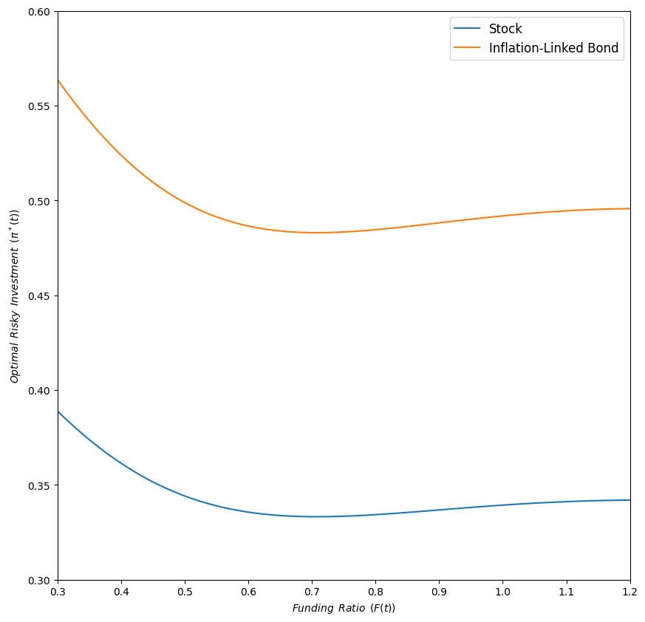
Optimal Asset Allocation
4. Numerical Results
The fund manger prefers the asset with lower volatility.
As funding ratio climbs,
Allocation declines
Try to reach the goal at low funding ratio
Reduces risk as funding ratio rises.
At slightly below the target,
Allocation meets the minimum, trough
After trough,
Allocation rises to plateau
Downside risk diminishes
Strive for additional return.

Slide 25
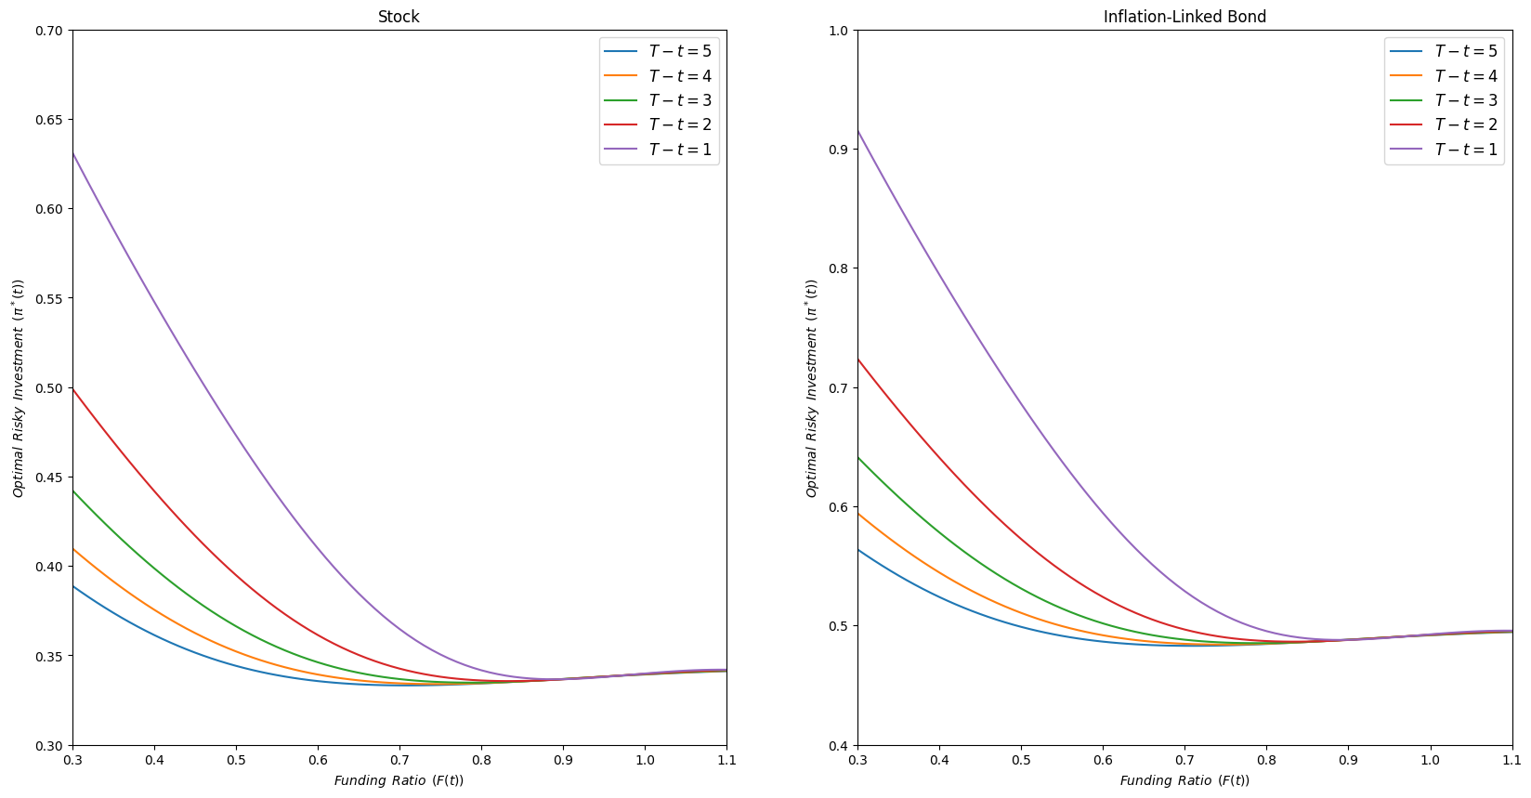
Effect of Investment Period
4. Numerical Results
Similar shape in previous figure.
As the period get shorter,
Invest more dynamically.
Try to meet the goal in shorter time.

Slide 26
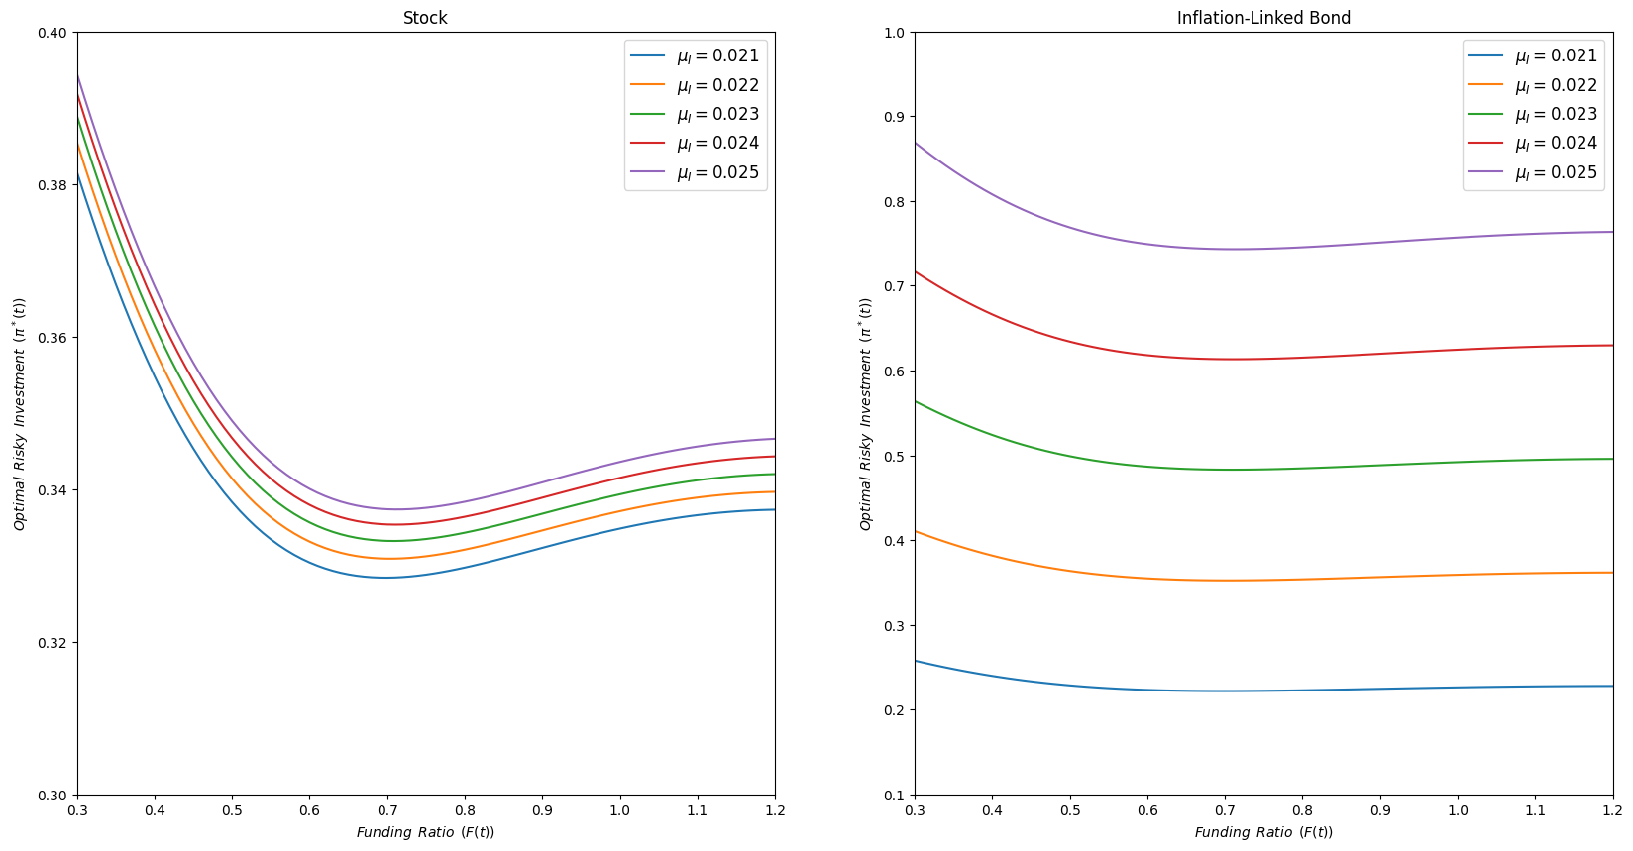
Effect of Expected Inflation Rate
4. Numerical Results
As the expected inflation rate rises,
Optimal allocation rises.
IIB naturally rises.
Stock rises since liability rises.
Stock exhibits a negative correlation with IIB.

Slide 27
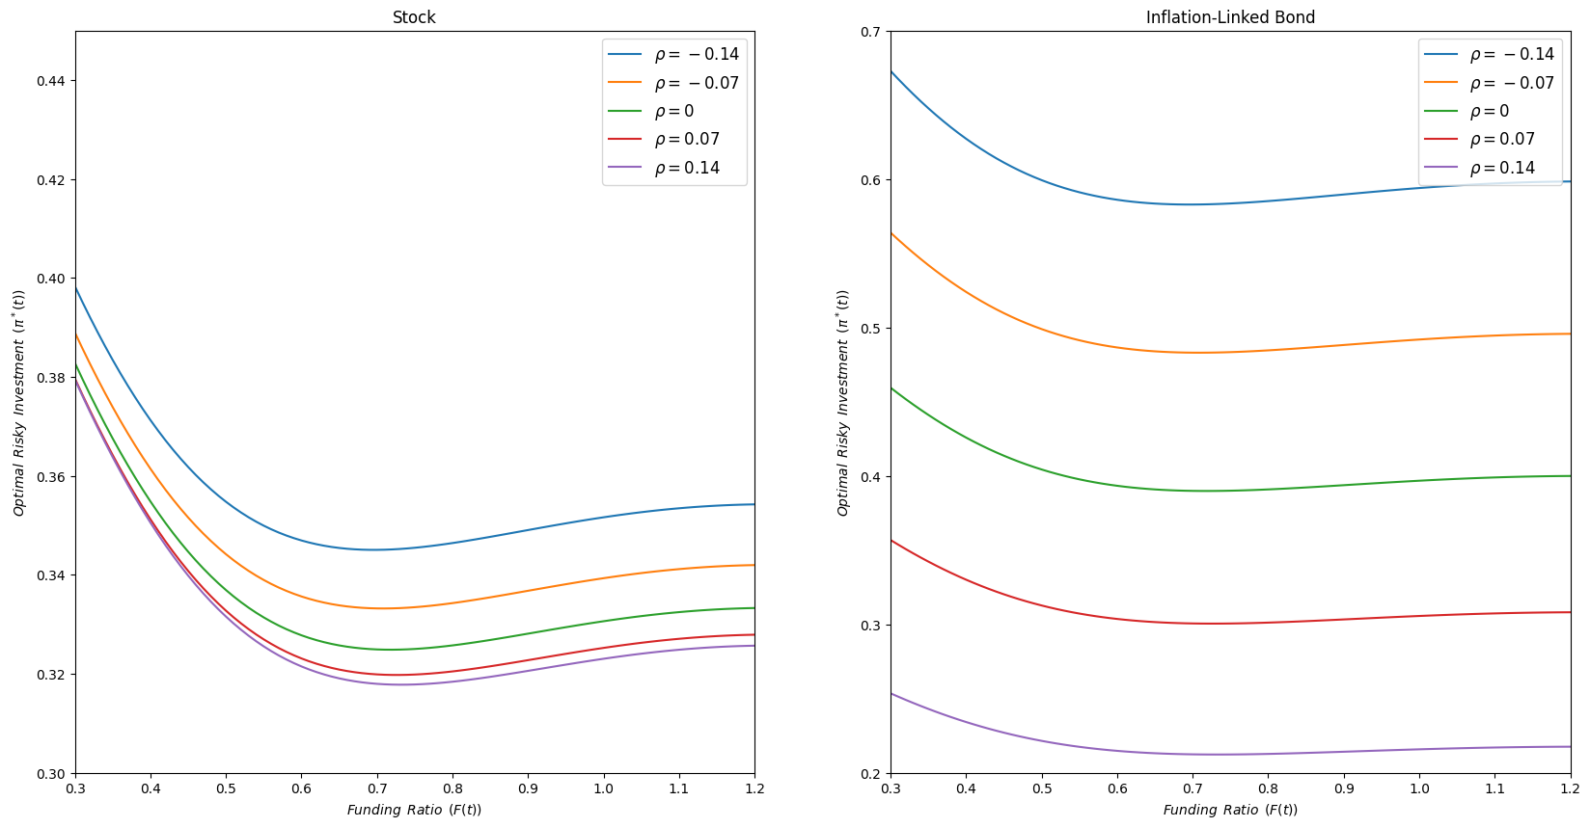
Effect of Correlation
4. Numerical Results
As the correlation rises,
Optimal allocation declines.
Lower correlation results in high hedging effect between risky assets.

Slide 28
5
Conclusion

Slide 29
Conclusion
5. Conclusion
Explores a liability-driven investment strategy under inflation risk, considering three asset classes: stocks, inflation-linked index bonds, and a risk-free asset.
Employ the CRRA utility function with respect to the funding ratio.
Impose a VaR constraint on the funding ratio.
Main findings:
Higher expected inflation rates lead to a greater allocation to both classes of risky assets.
This effect intensifies as the correlation between the two risky asset classes decreases.
The fund manager’s optimal investment strategies should change significantly based on the current funding ratio, with a shorter investment period resulting in greater variability in these strategies.
Derive a closed-form of the optimal investment strategy by extending the option-based approach first outlined by Kraft and Steffensen (2013).

Slide 30
E
nd of Document

